Slide 1






MIDTERM REVIEW SESSION
COMM 295
Prepared by: Saru Aggarwal

Slide 2
TABLE OF CONTENTS
Introduction
Supply and Demand
Production and Cost
Elasticity
Estimation and Regression Analyses
Perfectly Competitive Markets
Monopoly
Pricing With Market Power
Oligopoly

Slide 3
INTRODUCTION

Slide 4
Economic Theory
An economic theory refers to the development and use of a model to formulate hypotheses.
Useful theories are testable; i.e., if the price of a good increases, the quantity demanded of that product falls
Economic Models: simplified description of a reality
Describes a relationship between two or more variables
Does not need to be strictly accurate as long as it is a reasonably approximate
Contradiction: it is difficult to find idea conditions to test the model.
ex: human behavior depends on tastes, and tastes change randomly at random intervals

Slide 5
Positive and Normative Statements
A positive (or descriptive) statement is a testable assertion of fact
Can be true or false
e.g. advertising on the internet will increase the amount of monthly sales at a car dealership
A normative (or prescriptive) statement is belief about whether something is good or bad
Often a value judgment, not testable
e.g. A carbon tax is the best way to reduce GHG (greenhouse gas) emissions.
Why is it important?
In economic theory and analysis, we emphasize positive statements, as they are testable

Slide 6
Question 1
Which one of the following is a normative statement?
Higher advertising expenses lead to higher sales revenue.
You should study Commerce rather than Arts.
Commerce graduates earn higher incomes than Arts graduates.
High-risk actions taken by many financial institutions caused the “great recession” of 2007-2009.

Slide 7
DEMAND AND SUPPLY

Slide 8
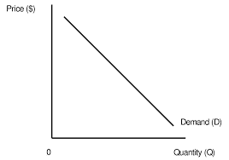
Law of Demand
Quantity demanded rises when price falls
ceteris paribus
Demand curve slopes downward
this is called movement along the demand curve
Empirical statement (lots of evidence supporting this law from observation of real markets)

Slide 9
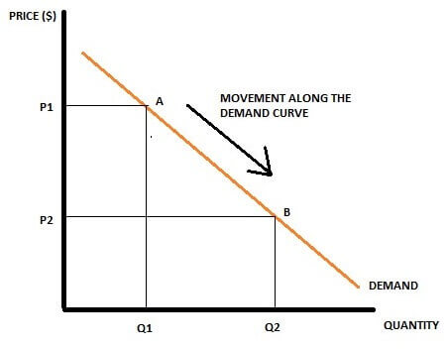
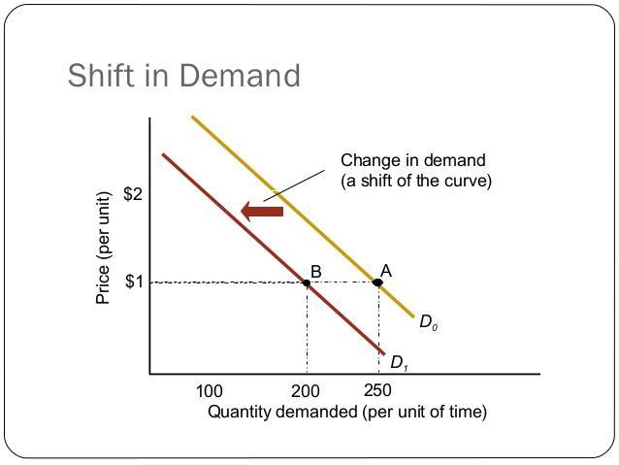
Two Types of Changes
1. Movement along the demand curve
Changes in Price
2. Shift in the demand curve
Entire demand curve shifts leftward or rightward as a result of change in demand determinants other than price

Slide 10
Shifts in Demand Curve
Changes in income (Y)
Changes in the prices of related goods (P_{r})
Changes in information
Change in consumer tastes
Other factors

Slide 11
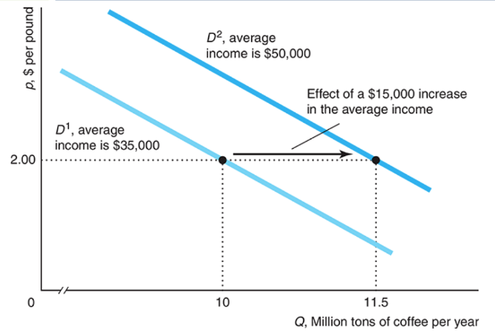
1. Changes in Income
Examples
You get a raise and now have a higher annual salary
Bureau of Labor Statistics reveals that inflation is continuing to remain at elevated levels (i.e. 8.2% YoY inflation)

Slide 12

2. Changes in the Prices of Related Goods
Think of substitutes and complements
Example: if the price of green apples decreases, the demand curve for red apples shifts left → substitutes
Market for Red Apples

Slide 13

2. Changes in the Prices of Related Goods
Example: if the price of coffee increases
Complement: cream
Market for Cream

Slide 14
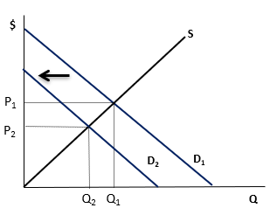
Question 2
Consider the market for coffee as shown below. Coffee is a normal good (demand increases when income increases). Which of the following events might have caused the demand curve to shift to the left (D1 to D2)?
New research about the benefits of drinking coffee
A decrease in consumer incomes
An increase in the price of tea
An increase in the price of coffee
B and C

Slide 15
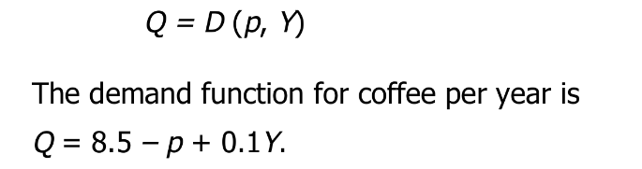
Demand Function
Demand Curve - The diagram showing the relationship between quantity demanded and the good’s price, ceteris paribus.
Demand Function: algebraic equation showing the effect of all relevant factors on the quantity demanded.
Ex:

Slide 16
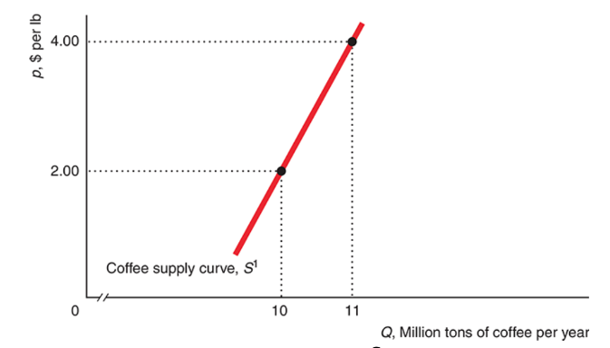
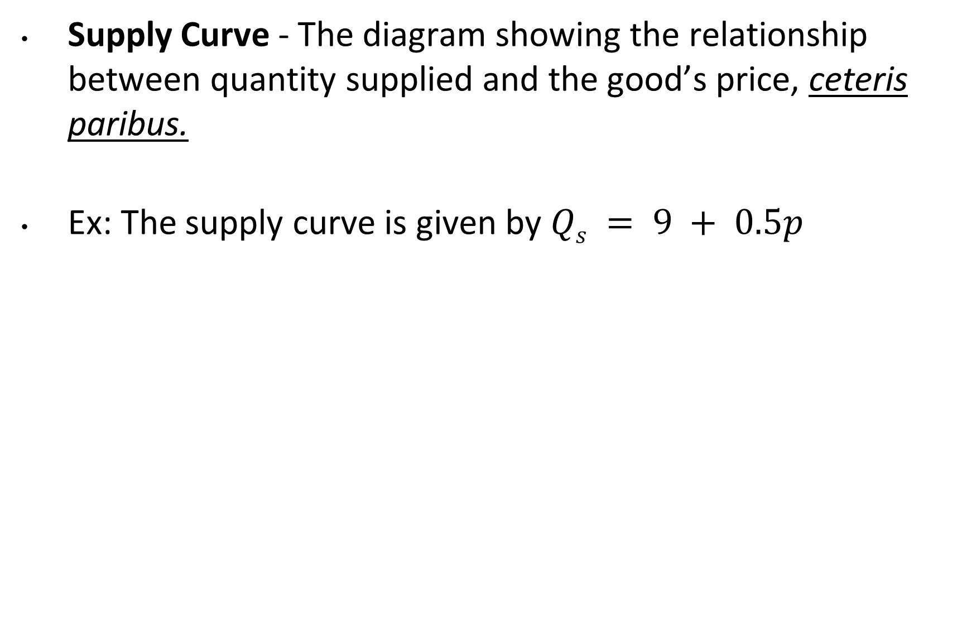
The Supply Curve
Supply Curve - The diagram showing the relationship between quantity supplied and the good’s price, ceteris paribus.
Ex: The supply curve is given by $Qs = 9 + 0.5p$

Slide 17
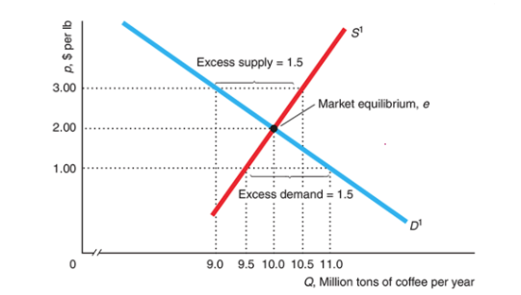
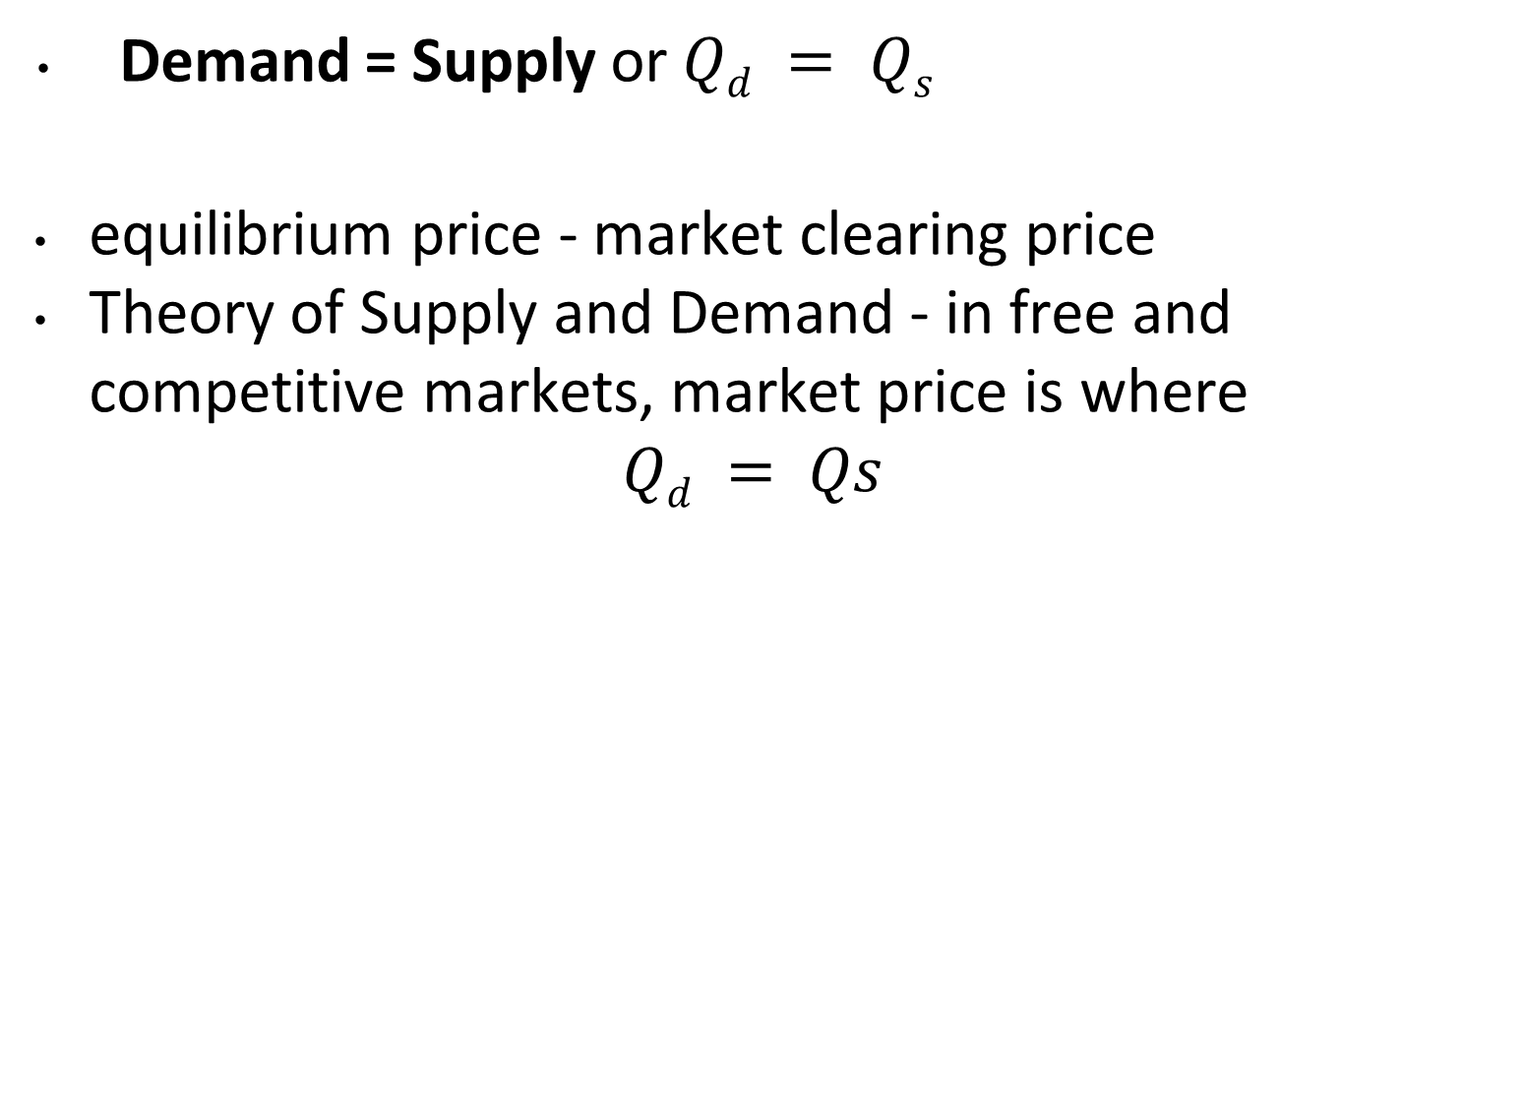
Market Equilibrium
Demand = Supply or $Qd = Qs$
equilibrium price - market clearing price
Theory of Supply and Demand - in free and competitive markets, market price is where
$$Qd = Qs$$

Slide 18
Question 3
Suppose that the market demand for avocados is characterized by the market demand equation Q = 100 - 4P and market supply for avocados is Q = 50 + P - 2P_{F}, where Q and P denote quantity demanded and price of avocados and P_{F} is the price of fertilizer.
(a) What is the relationship between avocados and fertilizer?
(b) Suppose P_{F} = 30 initially. Calculate the equilibrium price and quantity for avocados. Show this outcome in a clearly-labeled diagram.
(c) Suppose the price of fertilizer increases to P_{F} = 35. Show this change in the diagram you drew for part (b) and calculate the resulting equilibrium price and quantity for avocados.

Slide 19
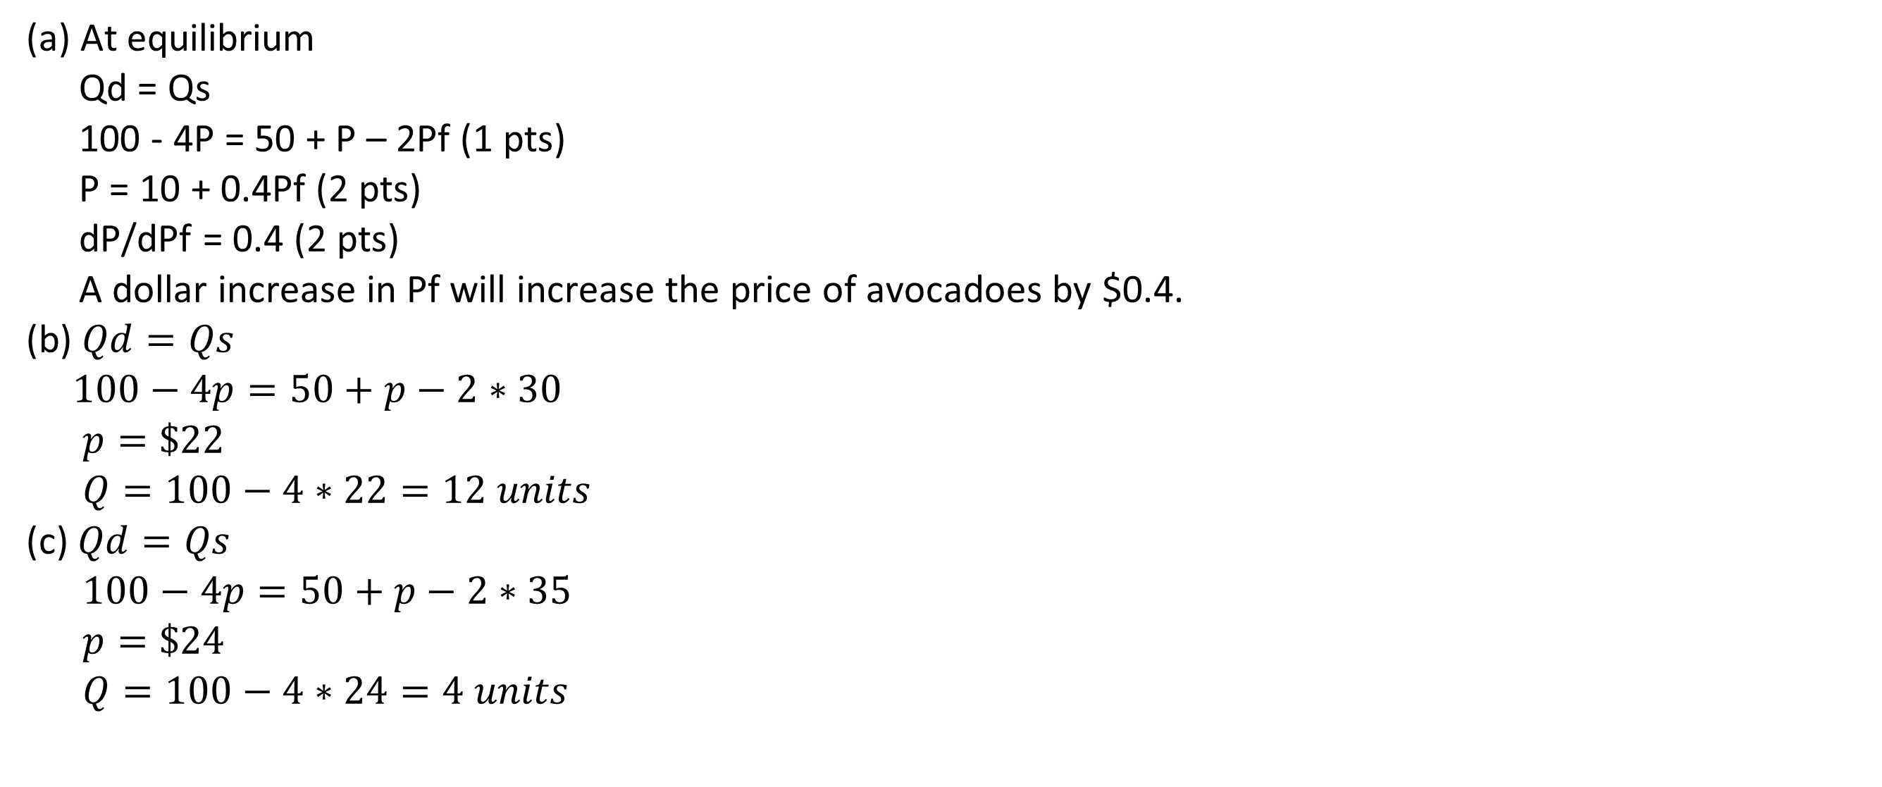
Question 3
(a) At equilibrium
Qd = Qs
100 - 4P = 50 + P – 2Pf (1 pts)
P = 10 + 0.4Pf (2 pts)
dP/dPf = 0.4 (2 pts)
A dollar increase in Pf will increase the price of avocadoes by $0.4.
(b) $Qd=Qs$
$100−4p=50+p−2∗30$
$p=\$22$
$Q=100−4∗22=12 units$
(c) $Qd=Qs$
$100−4p=50+p−2∗35$
$p=\$24$
$Q=100−4∗24=4 units$

Slide 20
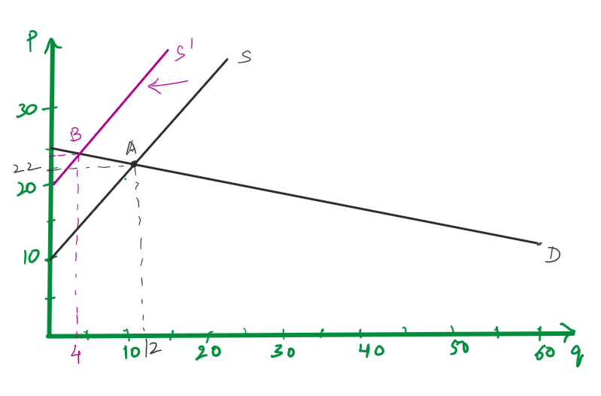
Question 3

Slide 21
PRODUCTION & COST

Slide 22
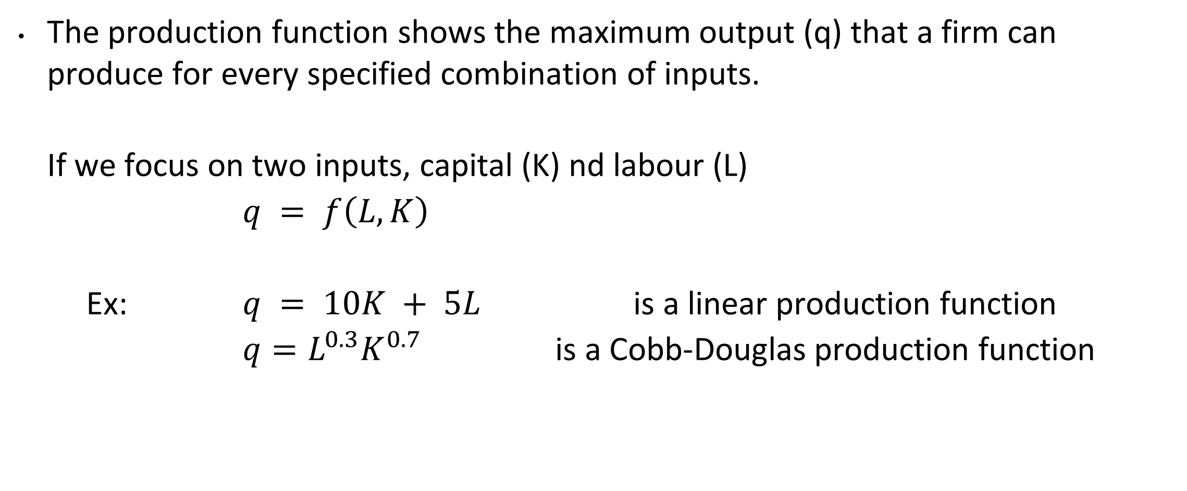
Production Function
The production function shows the maximum output (q) that a firm can produce for every specified combination of inputs.
If we focus on two inputs, capital (K) nd labour (L)
$q = f\left(L, K\right)$
Ex: $q = 10K + 5L$ is a linear production function
$q=L^{0.3}K^{0.7}$ is a Cobb-Douglas production function

Slide 23
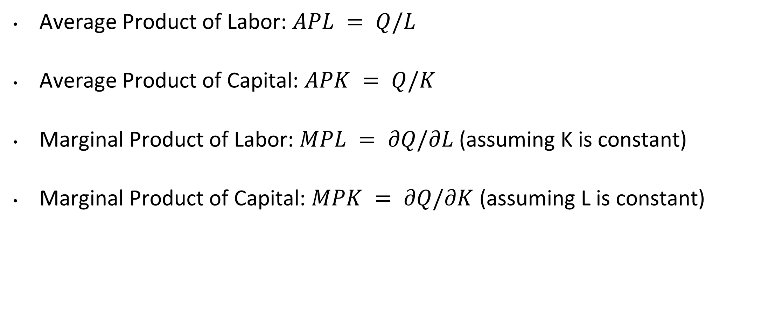
Measures of Productivity
Average Product of Labor: $APL = Q/L$
Average Product of Capital: $APK = Q/K$
Marginal Product of Labor: $MPL = ∂Q/∂L$(assuming K is constant)
Marginal Product of Capital: $MPK = ∂Q/∂K$(assuming L is constant)

Slide 24
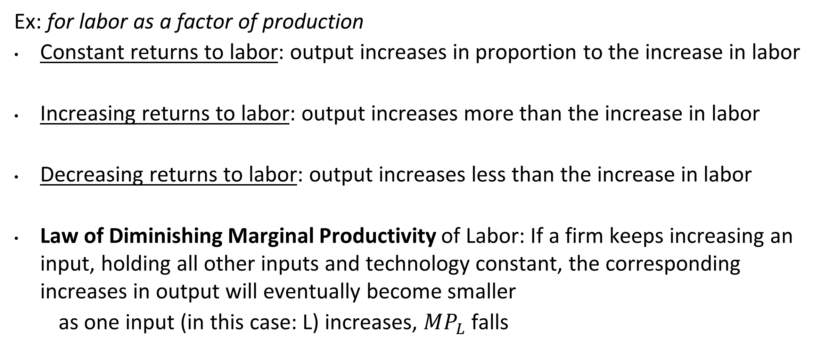
Returns to a Factor
Ex: for labor as a factor of production
Constant returns to labor: output increases in proportion to the increase in labor
Increasing returns to labor: output increases more than the increase in labor
Decreasing returns to labor: output increases less than the increase in labor
Law of Diminishing Marginal Productivity of Labor: If a firm keeps increasing an input, holding all other inputs and technology constant, the corresponding increases in output will eventually become smaller
as one input (in this case: L) increases, $MP_{L}$ falls

Slide 25
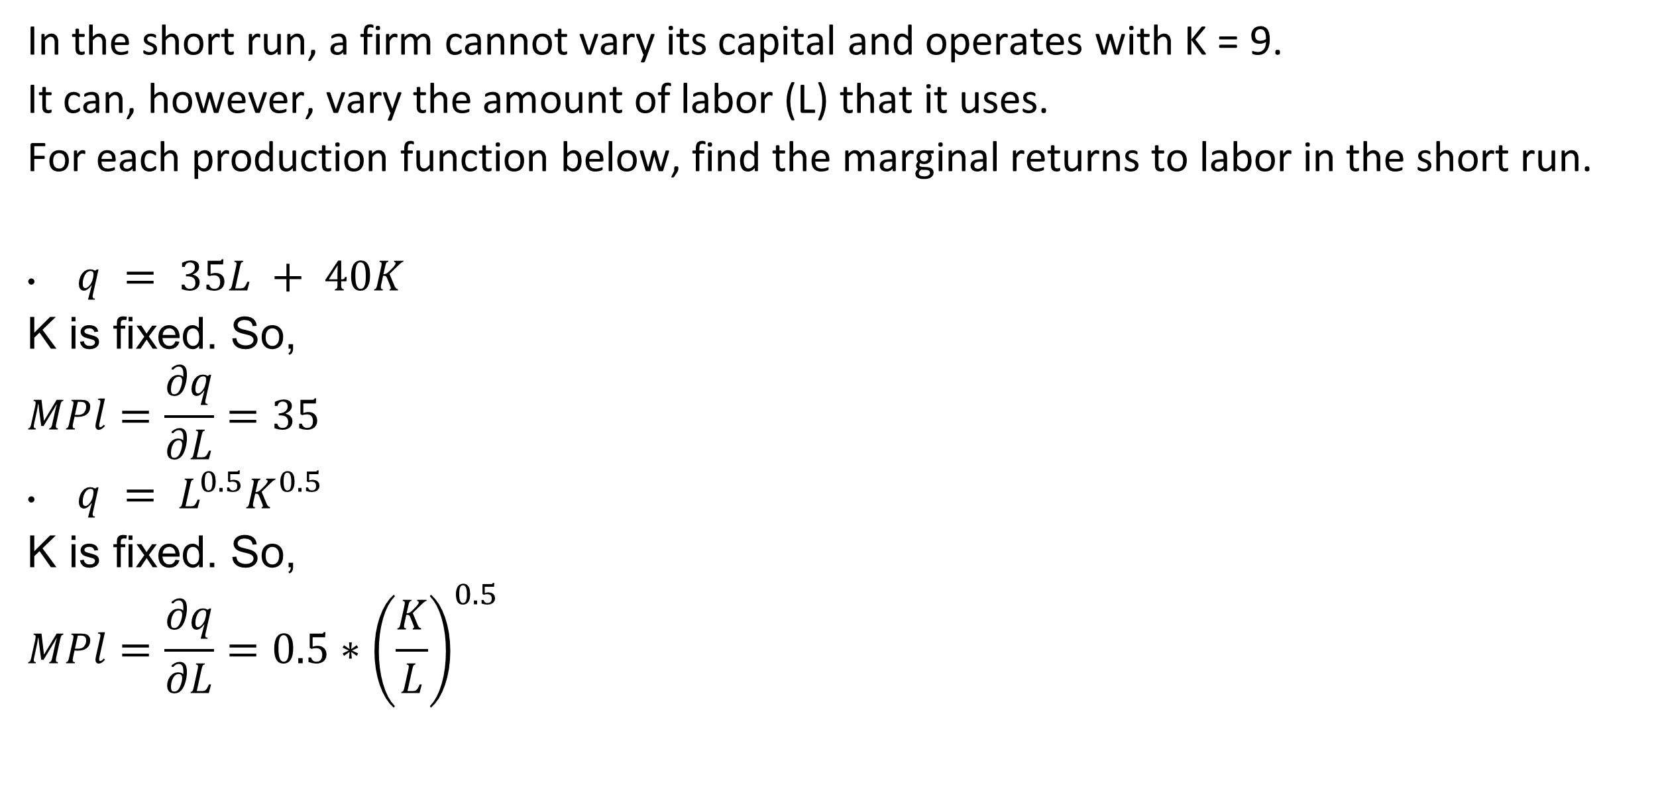
Question 4
In the short run, a firm cannot vary its capital and operates with K = 9.
It can, however, vary the amount of labor (L) that it uses.
For each production function below, find the marginal returns to labor in the short run.
$q = 35L + 40K$
K is fixed. So,
$$MPl=\frac{∂q}{∂L}=35$$
$q = L^{0.5}K^{0.5}$
K is fixed. So,
$$MPl=\frac{∂q}{∂L}=0.5∗{\left(\frac{K}{L}\right)}^{0.5}$$

Slide 26
Long Run Production - Returns to Scale
Constant returns to scale: output increases in proportion to the increase in input
Increasing returns to scale: output increases more than the increase in input
Decreasing returns to scale: output increases less than the increase in input

Slide 27
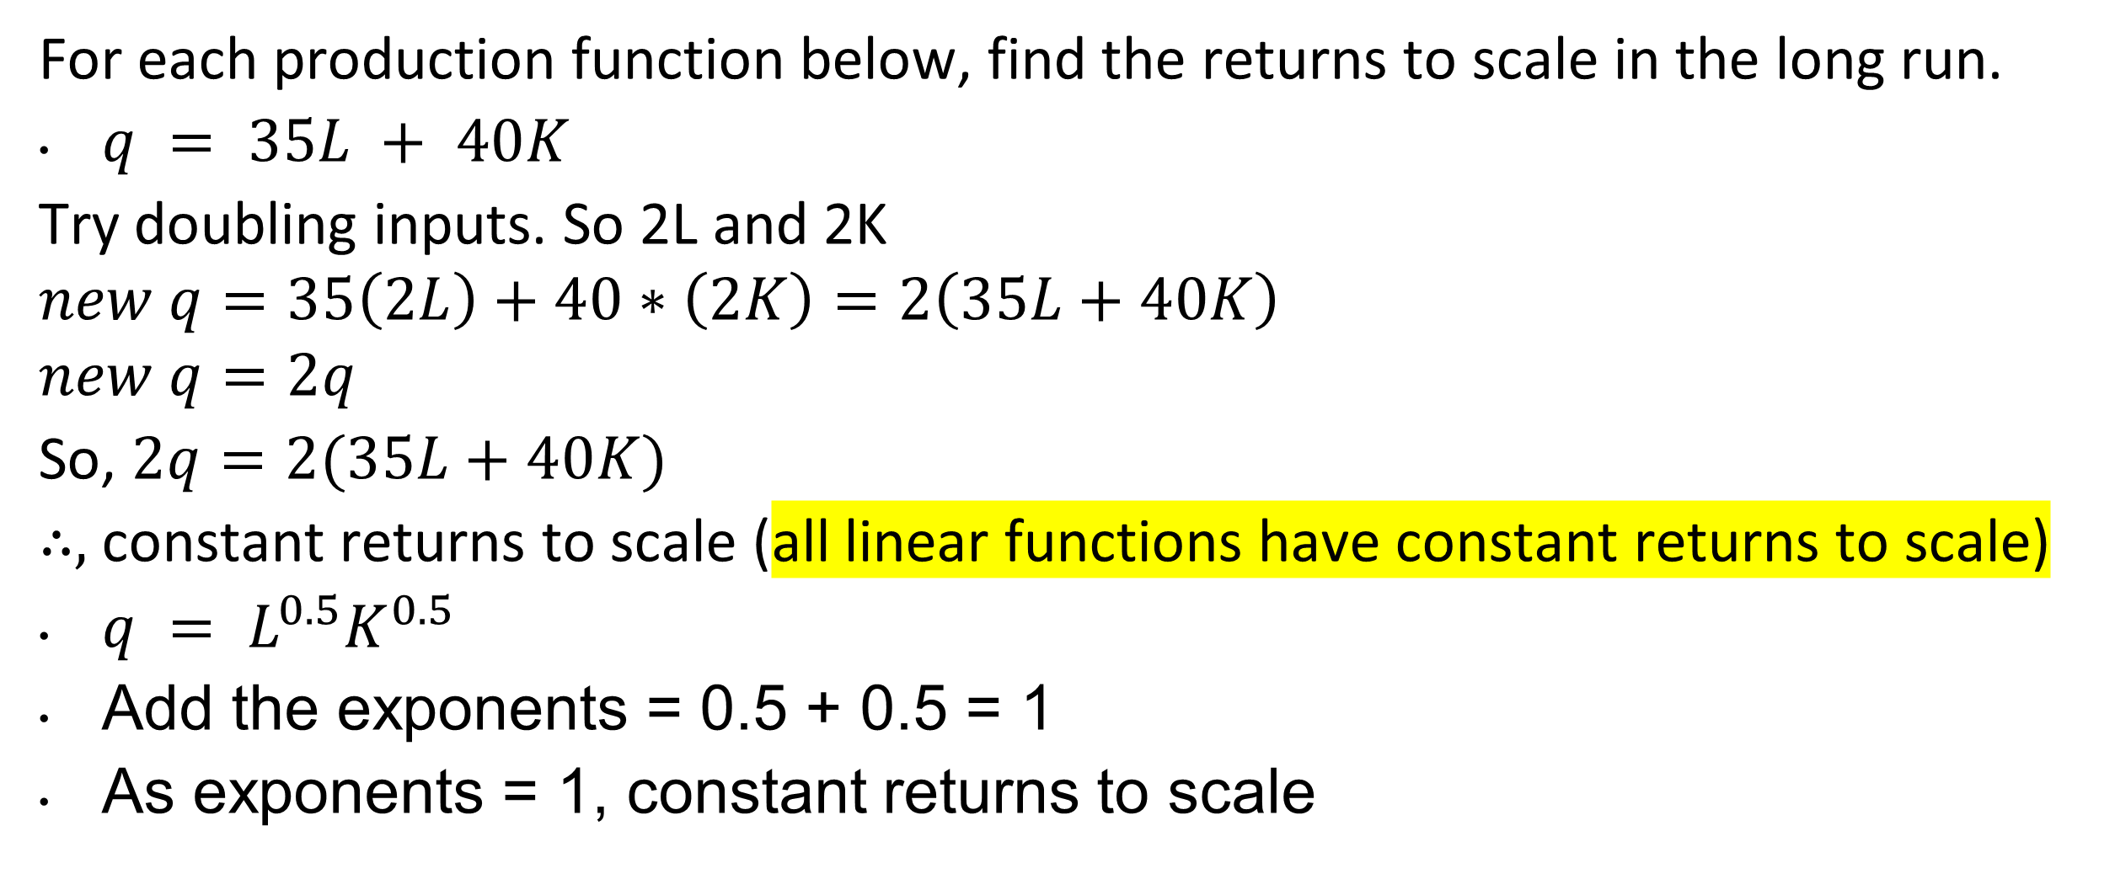
Question 5
For each production function below, find the returns to scale in the long run.
$q = 35L + 40K$
Try doubling inputs. So 2L and 2K
$$new q=35\left(2L\right)+40∗\left(2K\right)=2\left(35L+40K\right)$$
$$new q=2q$$
So, $2q=2(35L+40K)$
$∴,$constant returns to scale (all linear functions have constant returns to scale)
$q = L^{0.5}K^{0.5}$
Add the exponents = 0.5 + 0.5 = 1
As exponents = 1, constant returns to scale

Slide 28
Economies of Scale
Economies of scale mean that the average cost falls as output rises.
Constant costs means average cost is constant as output rises.
Diseconomies of scale means average cost rises as output rises.
Economies of scale are normally caused by increasing returns to scale.
Economies of scale is a cost concept; increasing returns to scale is a production concept.
They are related but are not the same thing.

Slide 29
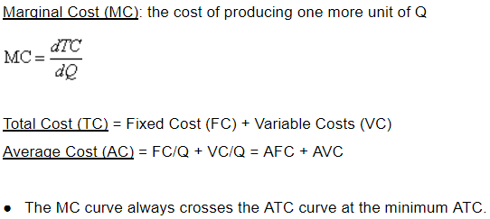
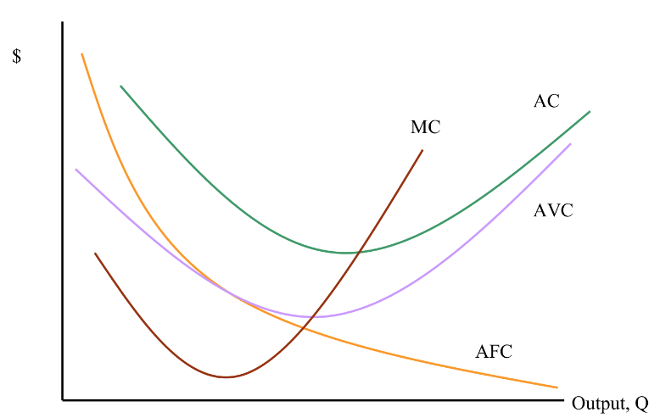
Costs

Slide 30

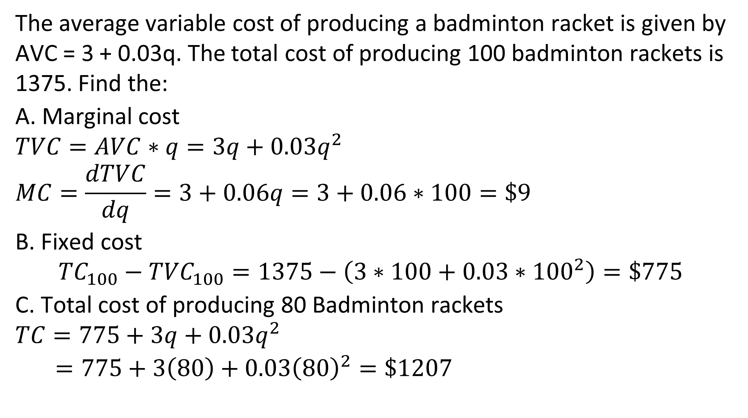
Question 6
The average variable cost of producing a badminton racket is given by AVC = 3 + 0.03q. The total cost of producing 100 badminton rackets is 1375. Find the:
A. Marginal cost
$$TVC=AVC∗q=3q+0.03q^{2}$$
$$MC=\frac{dTVC}{dq}=3+0.06q=3+0.06∗100=\$9$$
B. Fixed cost
$${TC}_{100}−{TVC}_{100}=1375−\left(3∗100+0.03∗{100}^{2}\right)=\$775$$
C. Total cost of producing 80 Badminton rackets
$$TC=775+3q+0.03q^{2}$$
$=775+3\left(80\right)+0.03{\left(80\right)}^{2}=\$1207$

Slide 31
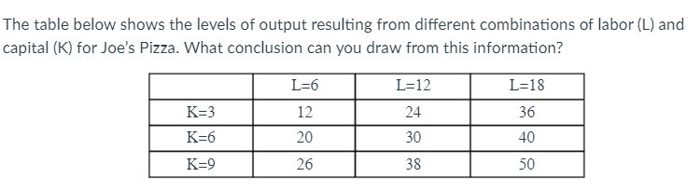
Question 7
Marginal productivity of K is increasing for all levels of L and K shown
Increasing returns to scale exist for all levels of production shown
Decreasing returns to scale exist for all levels of production shown
The marginal productivity of L is increasing for all levels of L and K shown

Slide 32
ELASTICITY

Slide 33
Price Elasticity of Demand
Textbook definition: measures the percentage change in the quantity demanded resulting from a percentage change in price.
In most cases, it is a negative number (negative relationship)
As price increases, quantity demanded decreases
As price decreases, quantity demanded increases
In case of luxury goods, it is positive (positive relationship)
As price increases, quantity demanded increases
As price decreases, quantity demanded decreases
Another way of thinking: it is the responsiveness of quantity demanded to a change in price

Slide 34
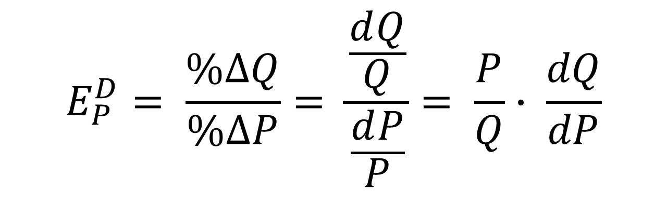
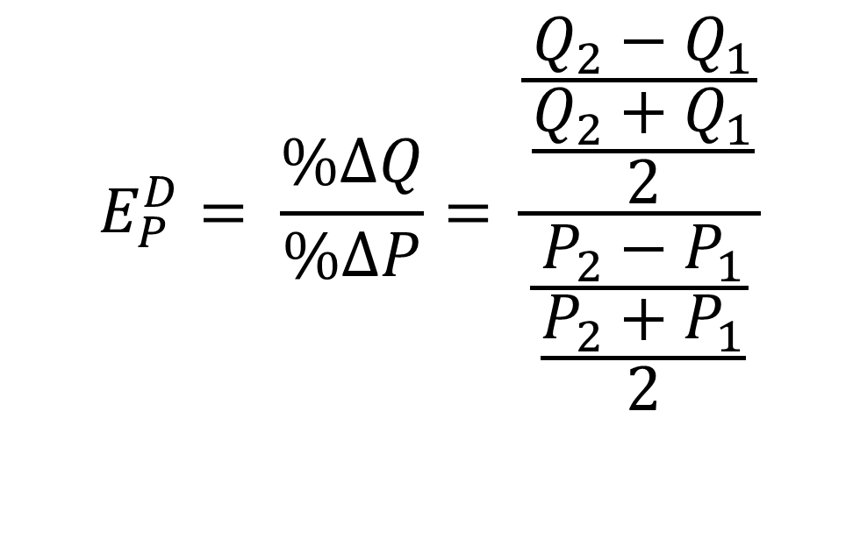
Arc Elasticity
Point Elasticity
$$E_{P}^{D}= \frac{\%∆Q}{\%∆P}= \frac{\frac{Q_{2}−Q_{1}}{\frac{Q_{2}+Q_{1}}{2}}}{\frac{P_{2}−P_{1}}{\frac{P_{2}+P_{1}}{2}}}$$
$$E_{P}^{D}= \frac{\%∆Q}{\%∆P}= \frac{\frac{ⅆQ}{Q}}{\frac{ⅆP}{P}}= \frac{P}{Q}∙ \frac{dQ}{dP}$$
Even with a linear demand curve, the price elasticity of demand is NOT the same at all points along the curve because it is calculated using % change.

Slide 35
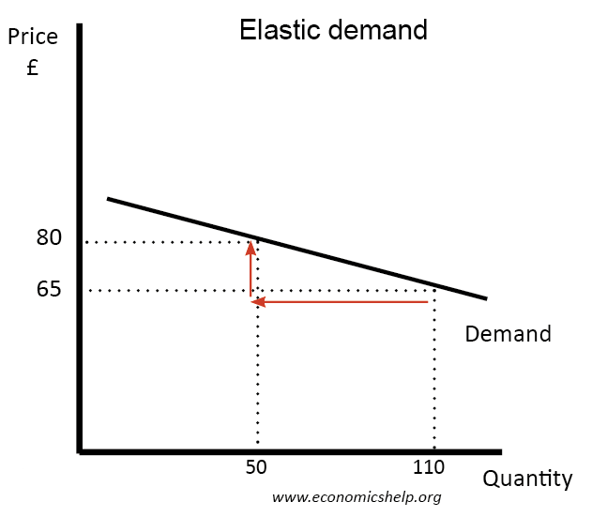
Elastic Demand
Demand for which a percentage change in a product’s price causes a larger percentage change in quantity demanded
Shown with a flatter curve
When |ε| > 1, it is price elastic
When demand is elastic, total revenue and the change in price have an inverse relationship → total revenue changes in the opposite direction to the change in price.

Slide 36
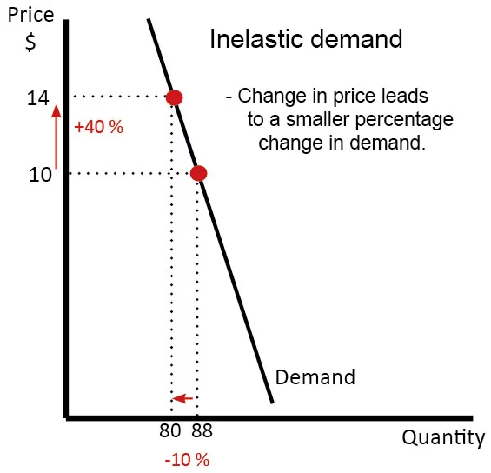
Inelastic Demand
Demand for which a percentage change in a product’s price causes a smaller percentage change in quantity demanded.
Shown with a steeper curve
When 0 < |ε| < 1, it is price inelastic
When the demand is inelastic, the price and total revenue have a direct relationship → total revenue changes in the same direction as the change in price.

Slide 37
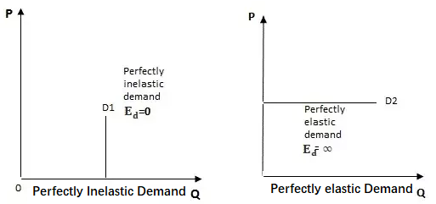
Perfectly Elastic and Perfectly Inelastic Demand

Slide 38
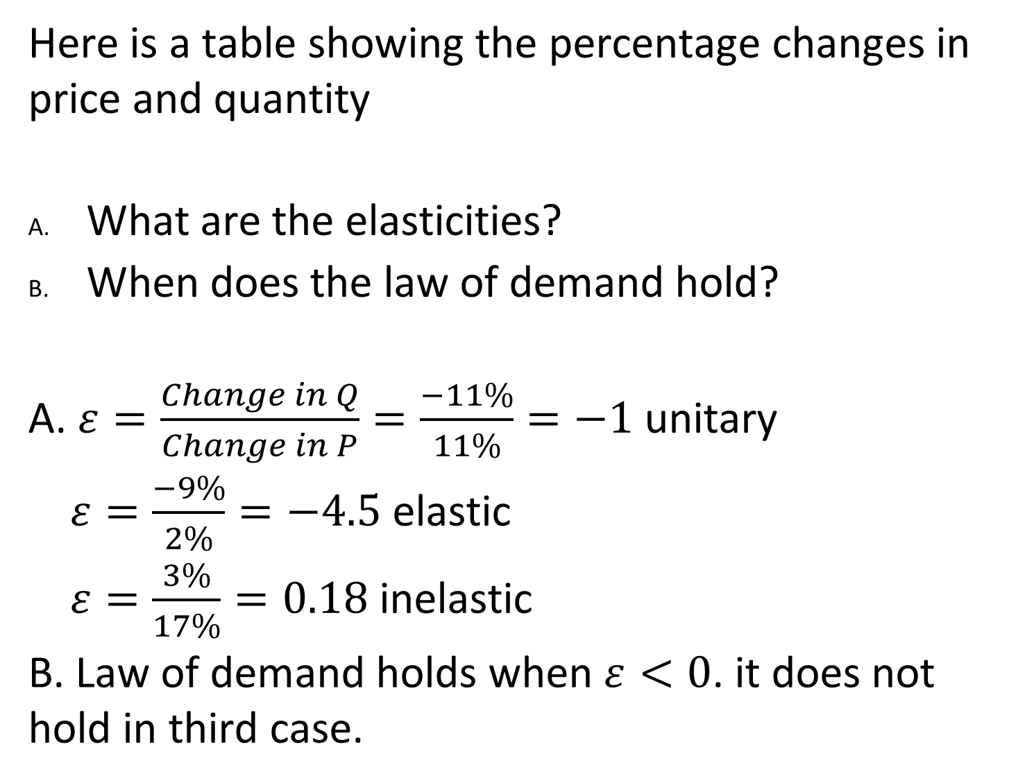
Question 8
Here is a table showing the percentage changes in price and quantity
What are the elasticities?
When does the law of demand hold?
A. $ε=\frac{Change in Q}{Change in P}=\frac{−11\%}{11\%}=−1$ unitary
$ε=\frac{−9\%}{2\%}=−4.5$ elastic
$ε=\frac{3\%}{17\%}=0.18$ inelastic
B. Law of demand holds when $ε<0$. it does not hold in third case.
Change in Quantity | Change in Price | Elasticity
-11% | 11% | ?
-9% | 2% | ?
3% | 17% | ?

Slide 39
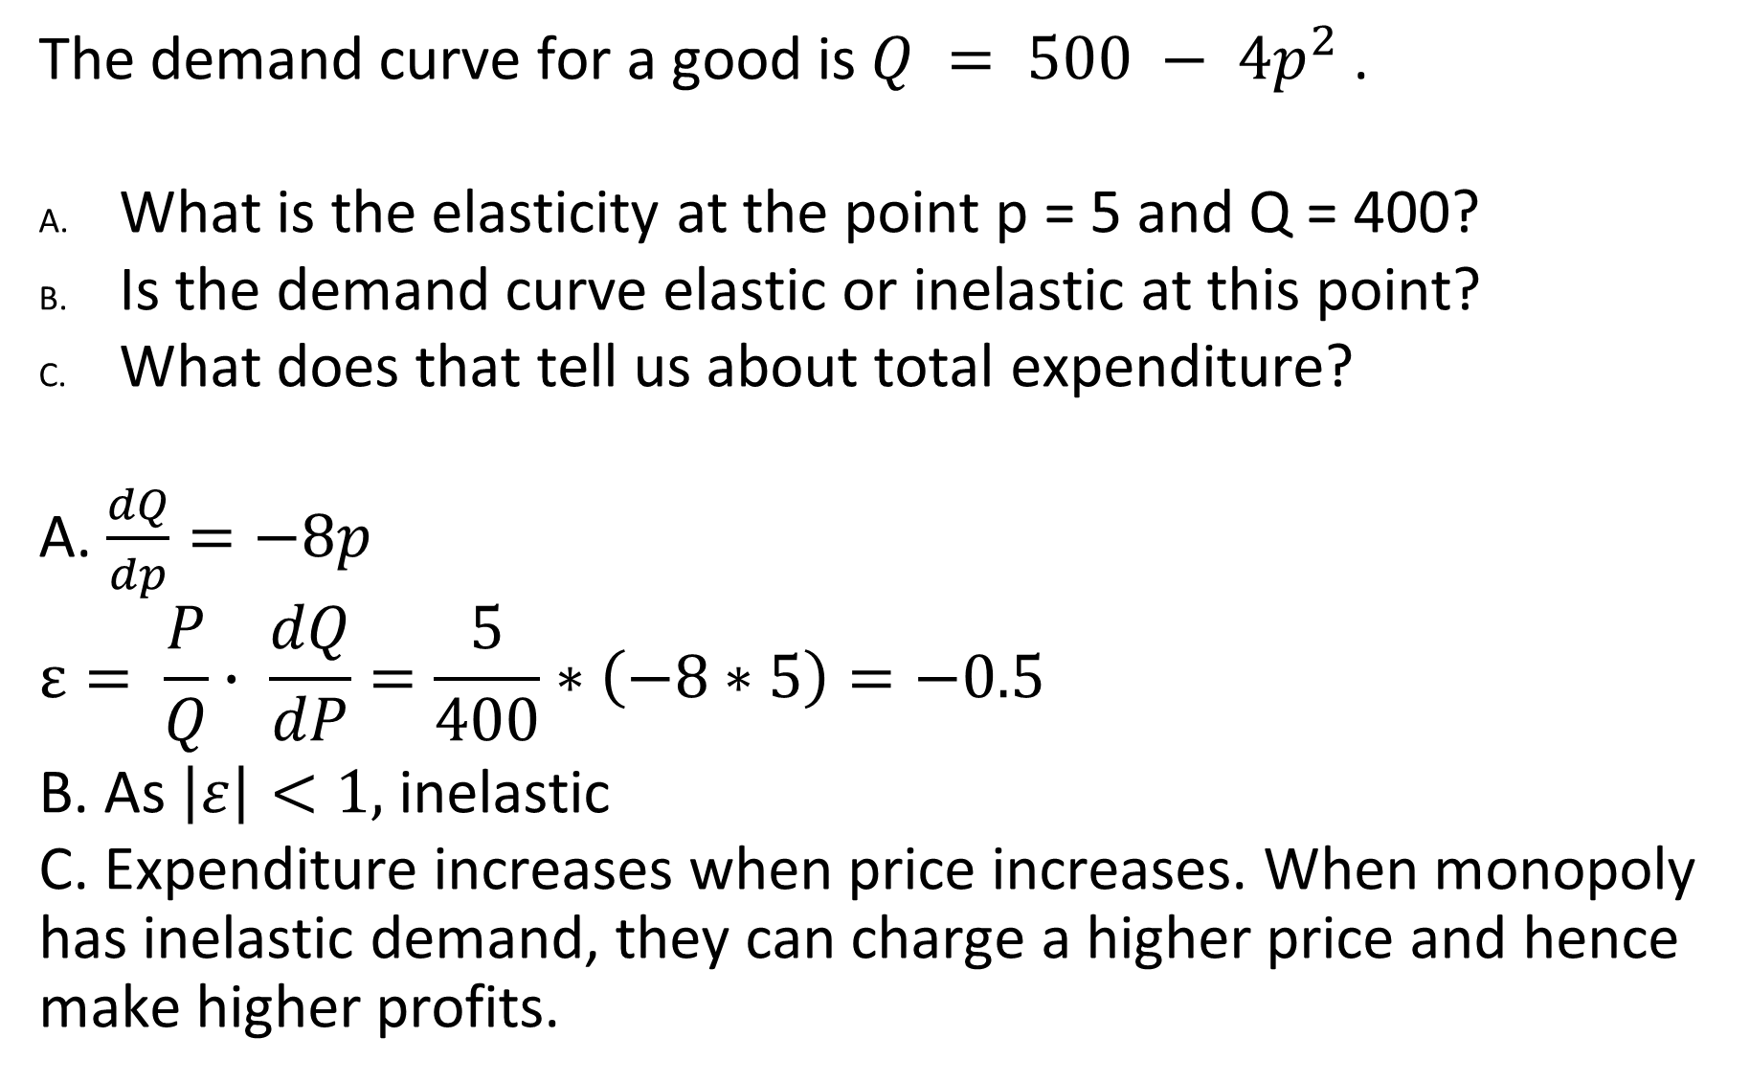
Question 9
The demand curve for a good is $Q = 500 − 4p^{2}$.
What is the elasticity at the point p = 5 and Q = 400?
Is the demand curve elastic or inelastic at this point?
What does that tell us about total expenditure?
A. $\frac{dQ}{dp}=−8p$
$$ε= \frac{P}{Q}∙ \frac{dQ}{dP}=\frac{5}{400}∗\left(−8∗5\right)=−0.5$$
B. As $\left|ε\right|<1,$ inelastic
C. Expenditure increases when price increases. When monopoly has inelastic demand, they can charge a higher price and hence make higher profits.

Slide 40
ESTIMATION AND REGRESSION ANALYSIS

Slide 41
Regression Analysis
It is statistical technique used to estimate the mathematical relationship between a dependent variable and one or more explanatory variables
It involves graphing the demand or supply curve using its determinants on the axes.
When estimating a demand curve, the points do not lie on the line precisely due to random error
The residual is the vertical distance between the estimated demand curve and the actual data points

Slide 42
Regression Analysis
When we use Excel, the method of “ordinary least squares” is used
this method makes the sum of squared residuals as small as possible to form an estimated regression line
The degree to which a regression line is a “good fit” for the data can be measured by the R² value.
R² value: the proportion of total variance (of the response variable) that is explained by the model (the explanatory variable)
measures how well the estimated regression line fits the data
When R² is 1.0, 100% of the variation in the response variable is explained by the explanatory variable

Slide 43
Regression Analysis
Standard error: how much the estimated coefficient would vary in repeated samples
Small standard errors indicate precise estimates
Various estimated coefficients are tightly bunched around the true coefficient
T-statistic: equals the coefficient divided by the standard error
Larger t-statistics indicate greater confidence that the true coefficient differs from zero
When the absolute value of the t-statistic is greater than 2, it is considered important or “statistically significant”

Slide 44
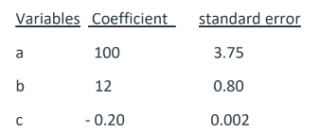
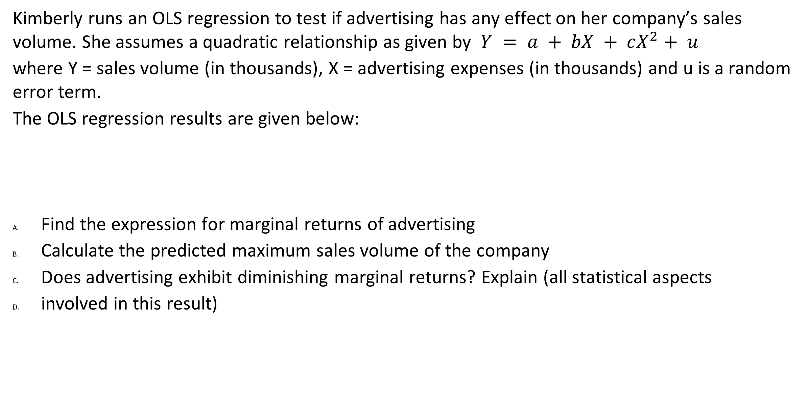
Question 10
Kimberly runs an OLS regression to test if advertising has any effect on her company’s sales volume. She assumes a quadratic relationship as given by $Y = a + bX + cX^{2}+ u$
where Y = sales volume (in thousands), X = advertising expenses (in thousands) and u is a random error term.
The OLS regression results are given below:
Find the expression for marginal returns of advertising
Calculate the predicted maximum sales volume of the company
Does advertising exhibit diminishing marginal returns? Explain (all statistical aspects
involved in this result)

Slide 45
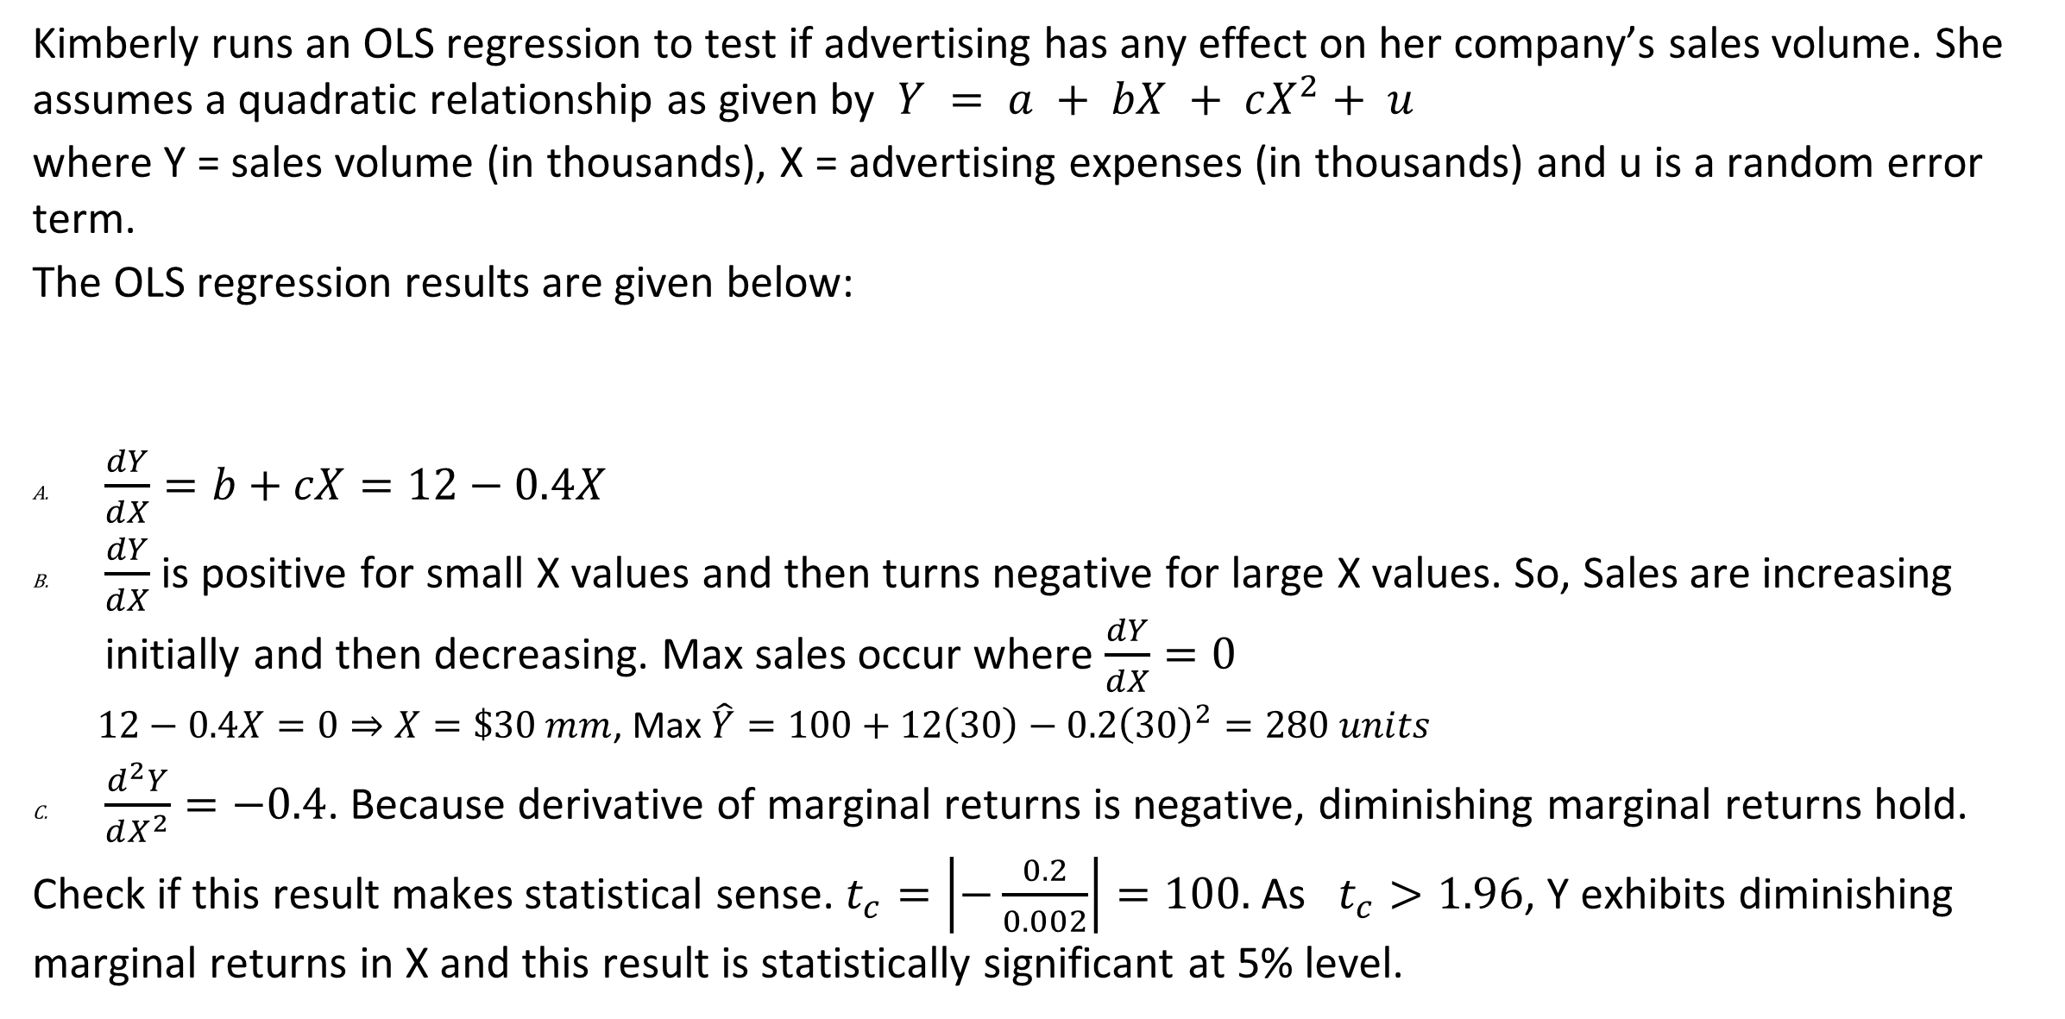
Question 10
Kimberly runs an OLS regression to test if advertising has any effect on her company’s sales volume. She assumes a quadratic relationship as given by $Y = a + bX + cX^{2}+ u$
where Y = sales volume (in thousands), X = advertising expenses (in thousands) and u is a random error term.
The OLS regression results are given below:
$\frac{dY}{dX}=b+cX=12−0.4X$
$\frac{dY}{dX}$is positive for small X values and then turns negative for large X values. So, Sales are increasing initially and then decreasing. Max sales occur where $\frac{dY}{dX}=0$
$12−0.4X=0⇒X=\$30 mm$, Max $\hat{Y}=100+12\left(30\right)−0.2{\left(30\right)}^{2}=280 units$
$\frac{d^{2}Y}{dX^{2}}=−0.4$. Because derivative of marginal returns is negative, diminishing marginal returns hold.
Check if this result makes statistical sense. $t_{c}=\left|−\frac{0.2}{0.002}\right|=100.$ As $t_{c}>1.96$, Y exhibits diminishing marginal returns in X and this result is statistically significant at 5% level.

Slide 46
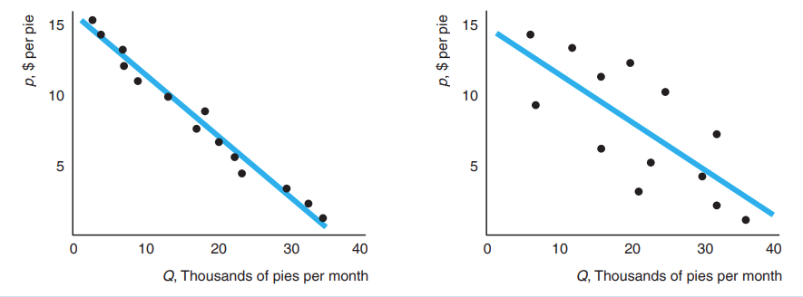
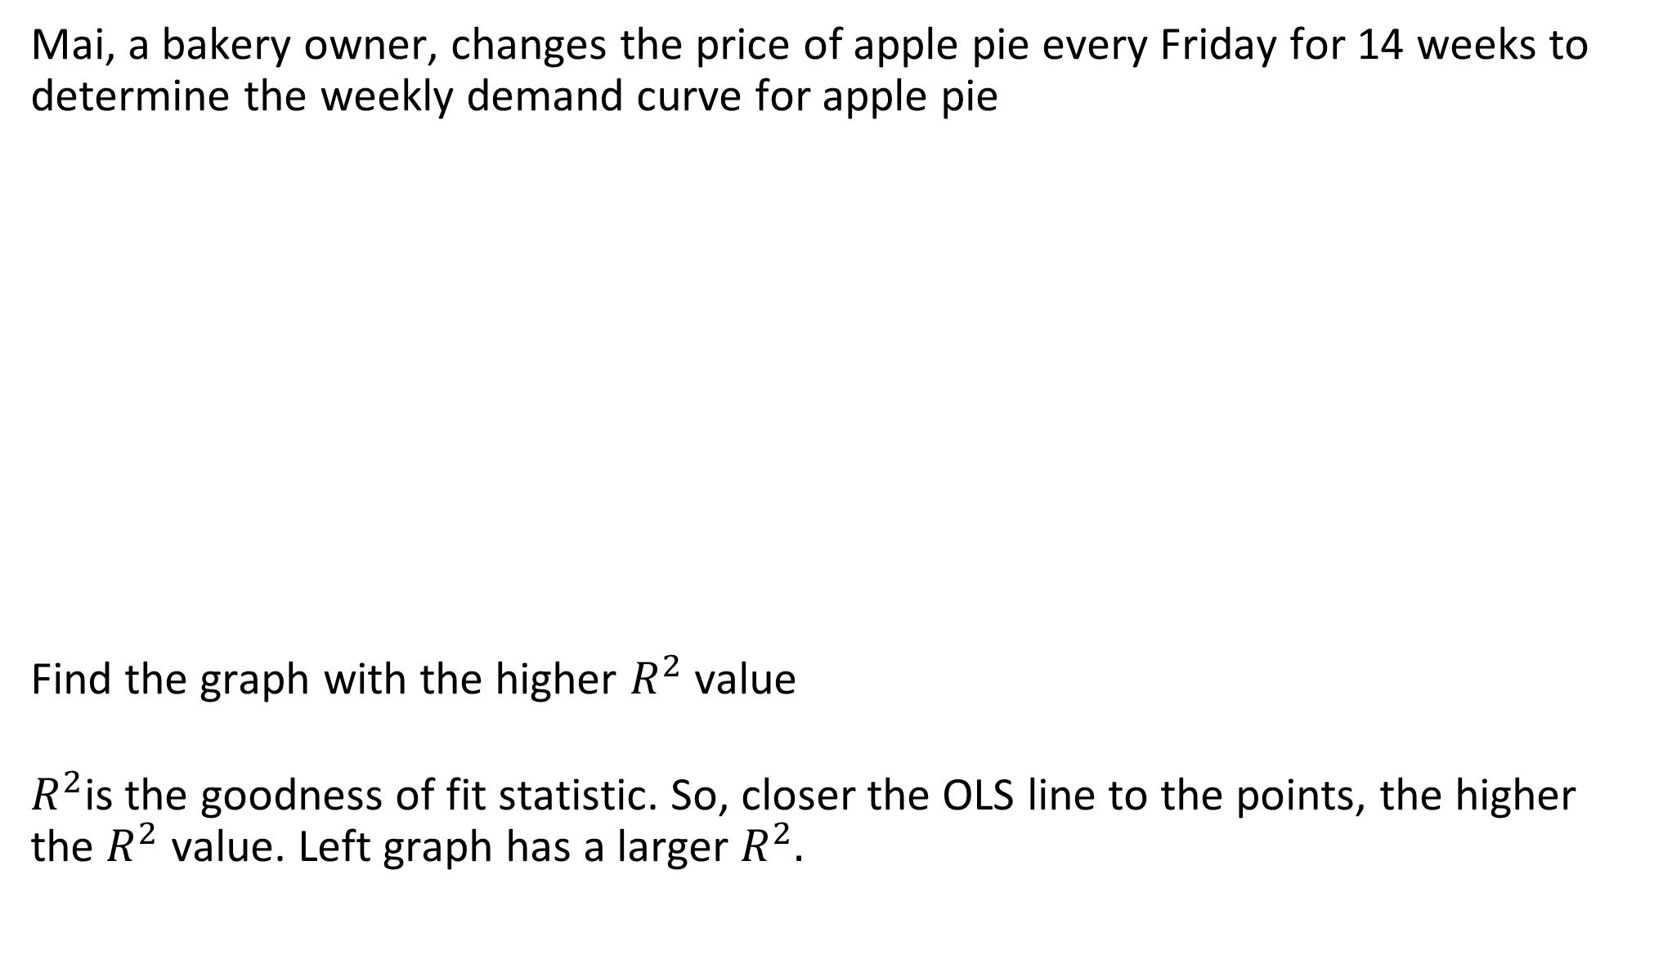
Question 11
Mai, a bakery owner, changes the price of apple pie every Friday for 14 weeks to determine the weekly demand curve for apple pie
Find the graph with the higher $R^{2}$ value
$R^{2}$is the goodness of fit statistic. So, closer the OLS line to the points, the higher the $R^{2}$ value. Left graph has a larger $R^{2}.$

Slide 47
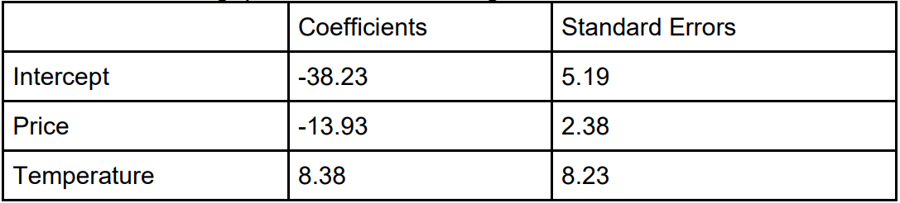
Question 12
Karen is selling watermelons in the UBC Farmers’ Market. She is curious about how the quantity of watermelons sold (Qs) is affected by the temperature of the day (T) and the price she sets. After collecting information about Q, P, and T in a single day, she runs a regression of Q on P and T. The results from the regression are shown in the table below, with R-squared statistic being 0.91. Answer the following questions about this regression.
1. The dependent variable is _____________________.
2. The estimated demand function is _______________________________.
3. The t-stat for the coefficient of temperature (T) is _________________ and the t-stat for the coefficient of price (P) is ______________________.
4. State whether the coefficients on temperature (T) and price (P) are statistically significant at the 5% significance level and explain how you know that.
5. After trying another regression specification by not including temperature (T) in
the regression, the R-squared statistic changes to 0.73. Is this new specification
better or worse than the original one?

Slide 48
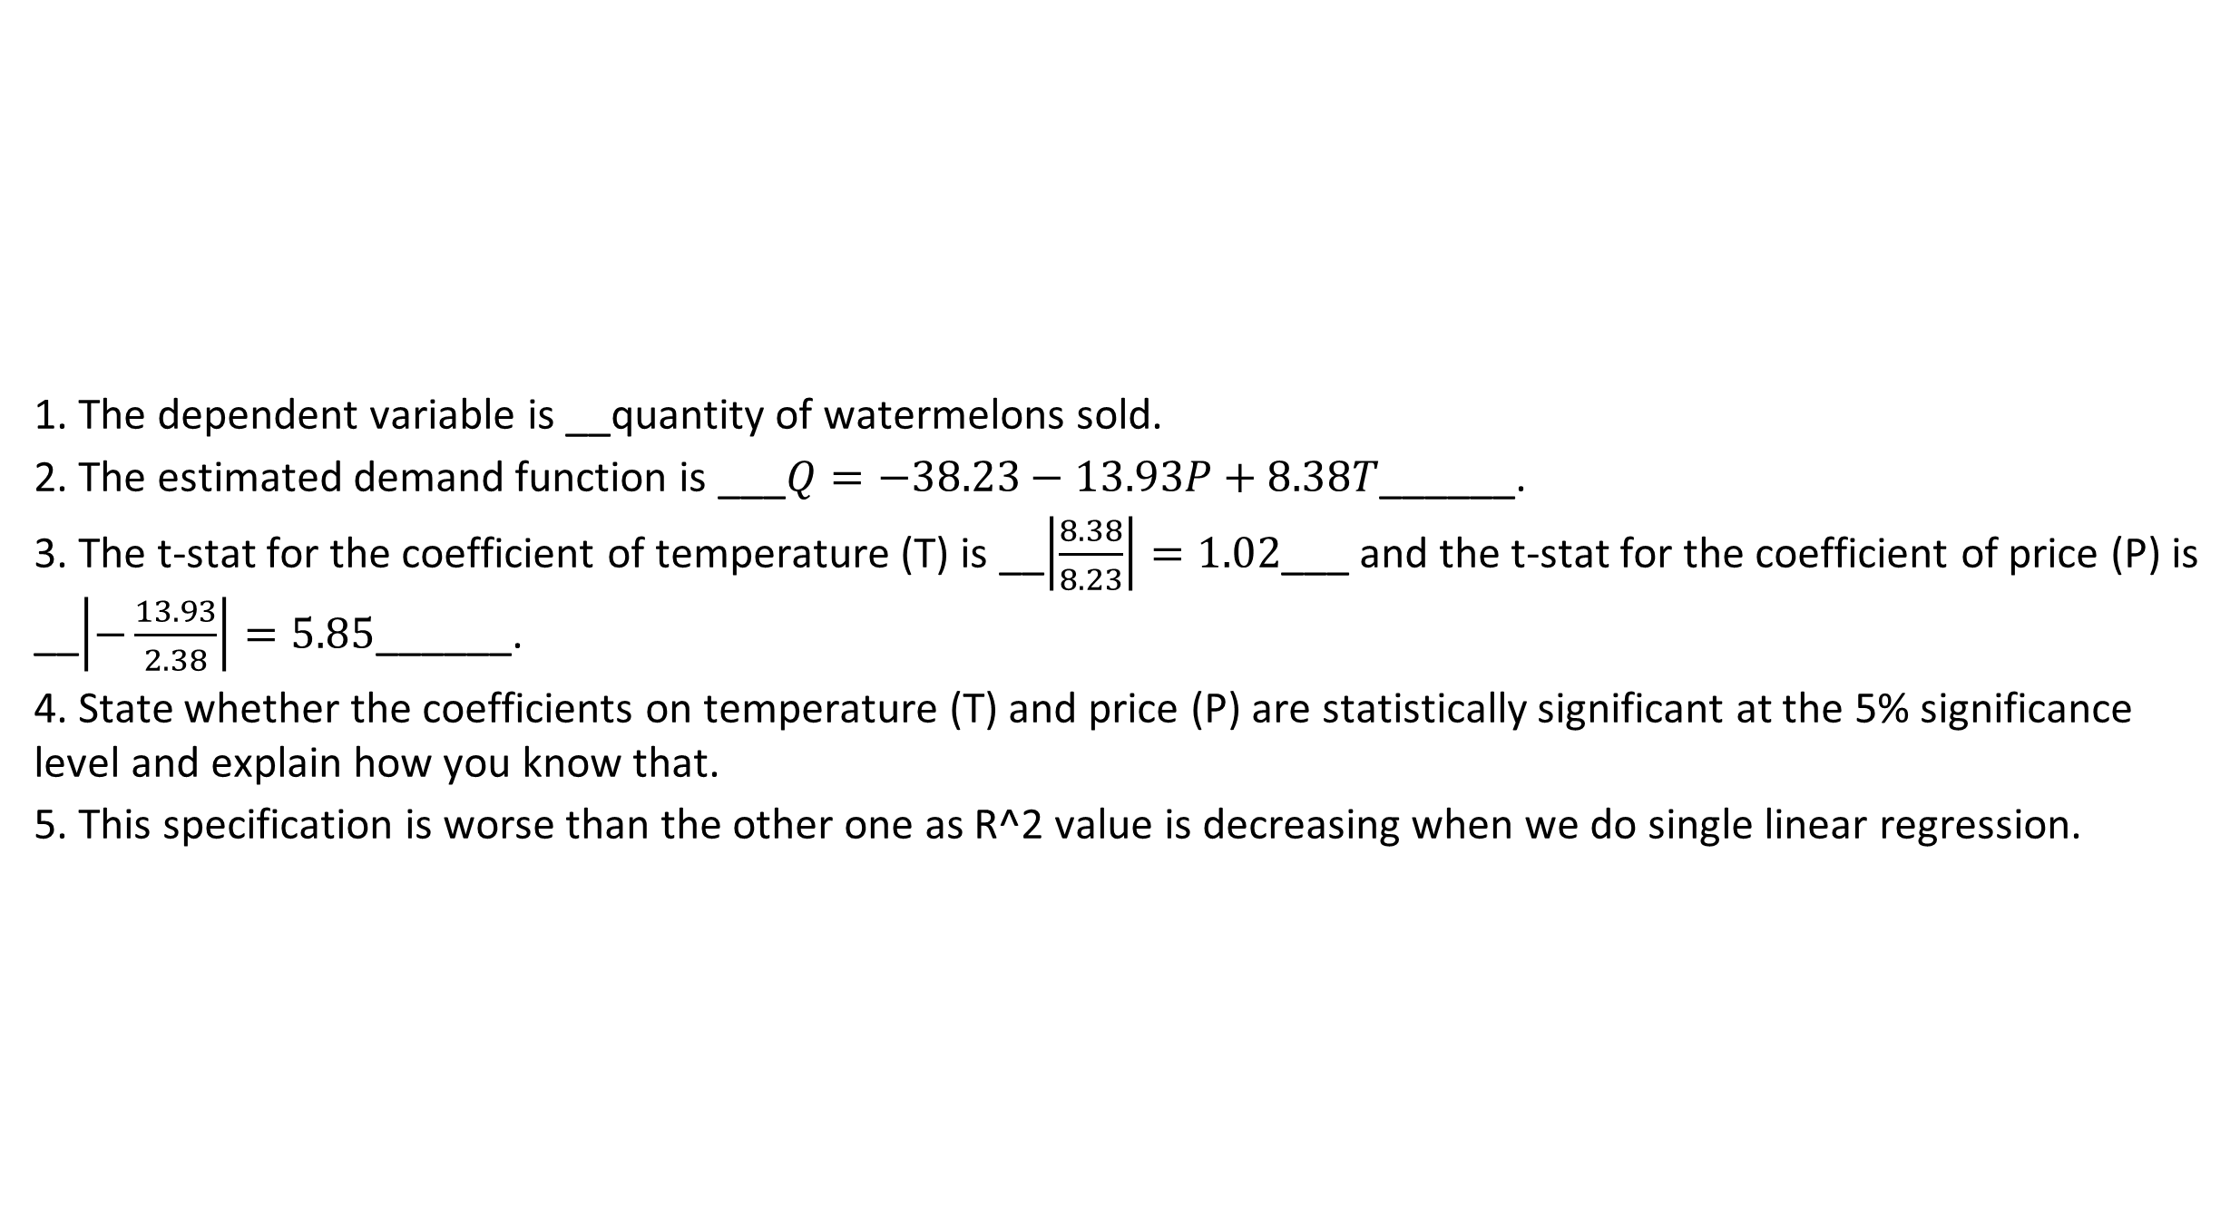
Question 12
1. The dependent variable is __quantity of watermelons sold.
2. The estimated demand function is ___$Q=−38.23−13.93P+8.38T$______.
3. The t-stat for the coefficient of temperature (T) is __$\left|\frac{8.38}{8.23}\right|=1.02$___ and the t-stat for the coefficient of price (P) is __$\left|−\frac{13.93}{2.38}\right|=5.85$______.
4. State whether the coefficients on temperature (T) and price (P) are statistically significant at the 5% significance level and explain how you know that.
5. This specification is worse than the other one as R^2 value is decreasing when we do single linear regression.

Slide 49
PERFECTLY COMPETITIVE MARKETS

Slide 50
Characteristics of Perfectly Competitive Firms
Price-Taking: The individual firm produces a very small share of the total market output and, therefore, cannot influence the market price
Product Homogeneity: The products of all firms are perfect substitutes
Freedom of Entry and Exit: There are no costs that make it difficult for a firm to enter or stay in the industry.
Perfect Information: Buyers and sellers have perfect information.
Low Transaction Costs: There are low transaction costs of buying and selling.

Slide 51
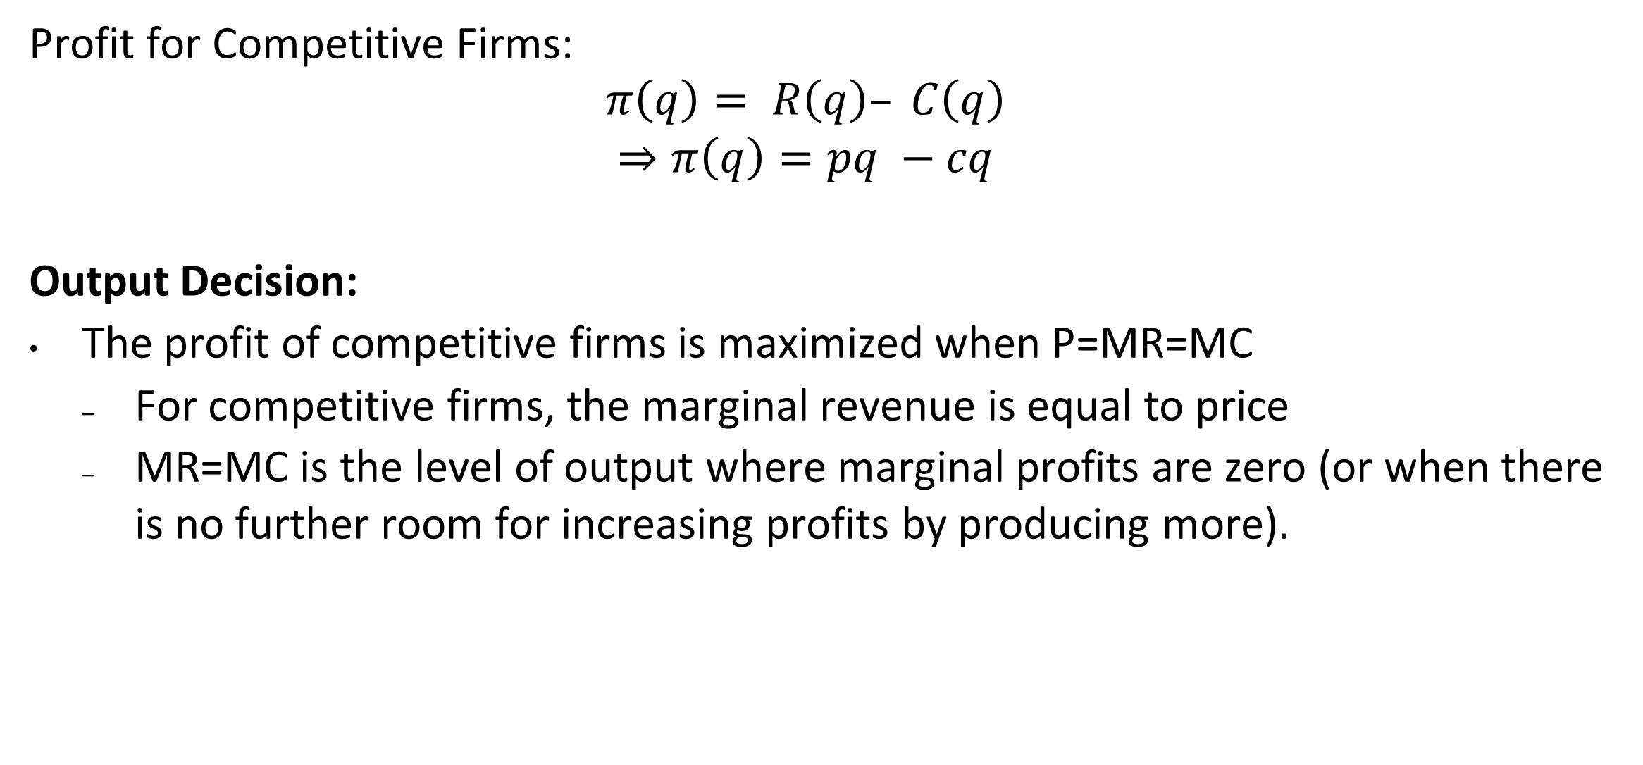
Characteristics of Perfectly Competitive Firms
Profit for Competitive Firms:
$$π\left(q\right)= R\left(q\right)– C\left(q\right)$$
$$⇒π\left(q\right)=pq −cq$$
Output Decision:
The profit of competitive firms is maximized when P=MR=MC
For competitive firms, the marginal revenue is equal to price
MR=MC is the level of output where marginal profits are zero (or when there is no further room for increasing profits by producing more).

Slide 52
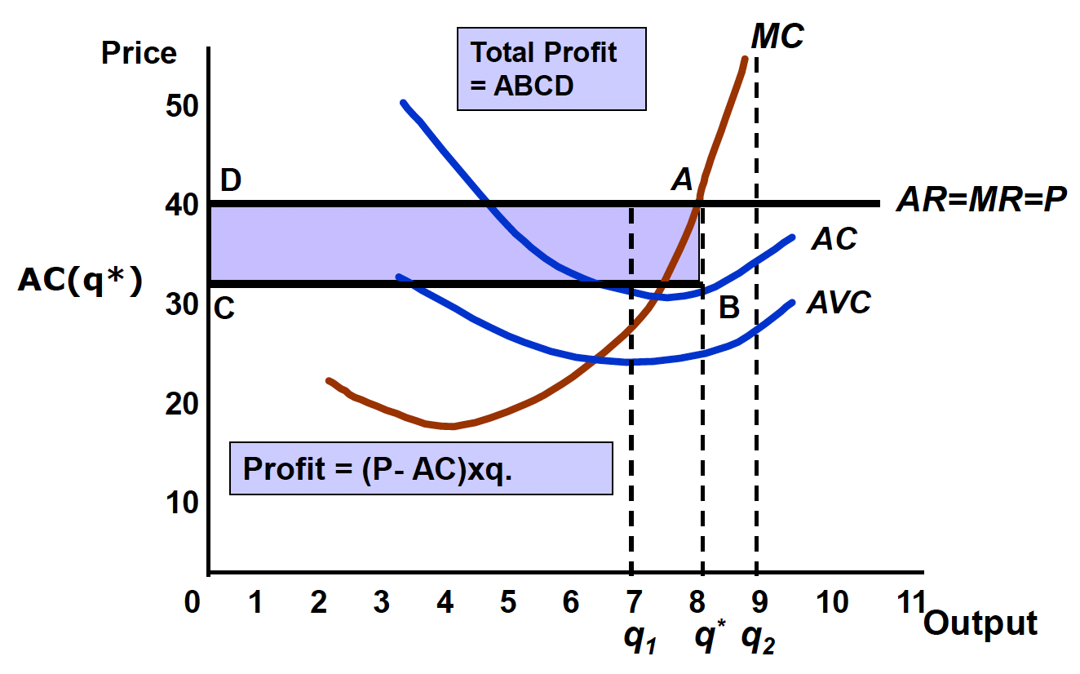
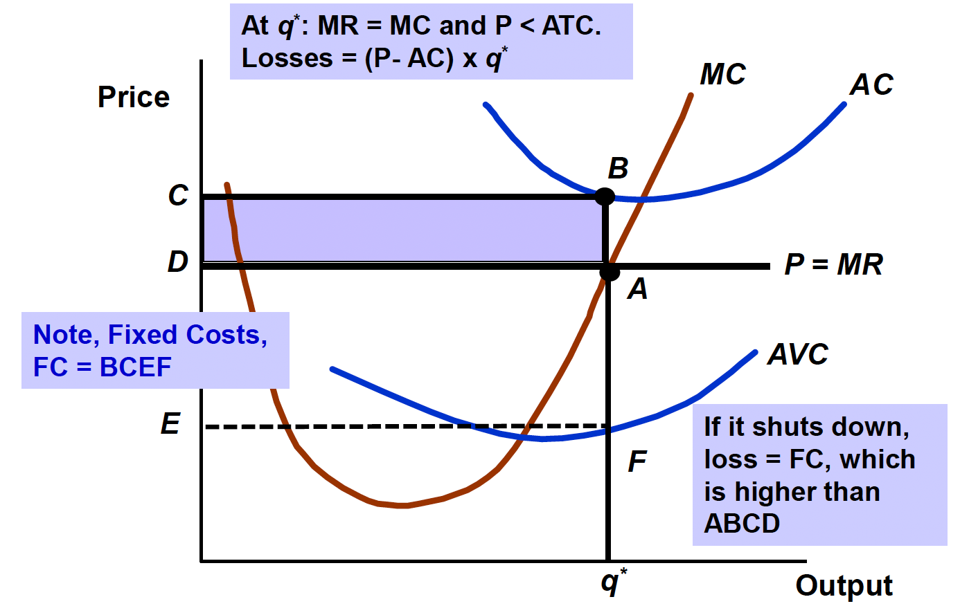
Characteristics of Perfectly Competitive Firms
When Q < Q*, marginal revenue is greater than marginal cost, meaning for each additional unit produced, the revenue will be higher
Firms will produce more
When Q > Q*, marginal revenue is less than marginal cost, meaning that for each extra unit produced, the cost will be higher than revenue.
firms will produce less
Q = Q* (MR=MC) is the sweet spot that allows a firm to maximize profit.

Slide 53
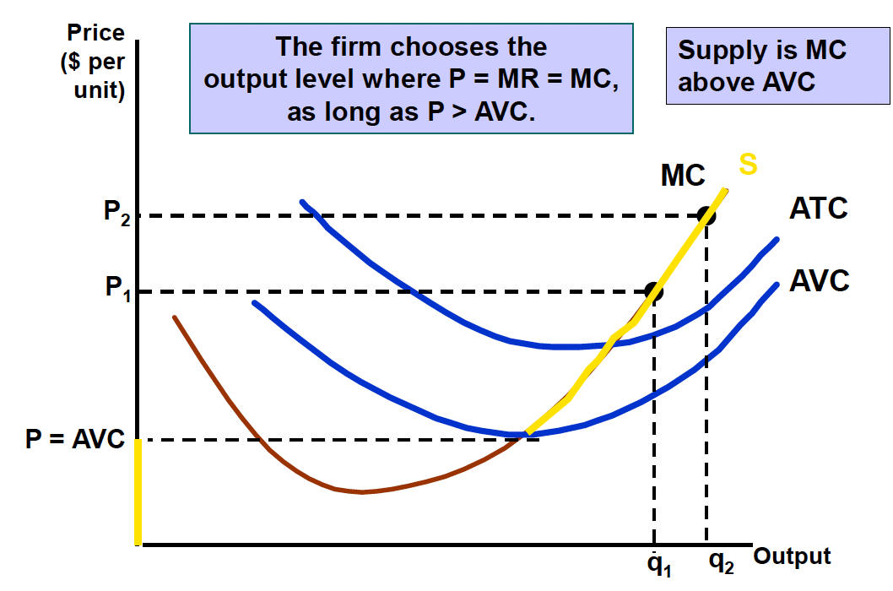
Short Run Shutdown Decision
If P > AVC, a firm will still produce even if it is experiencing a loss
This is because firms can reduce their losses by producing more when P > AVC
Revenue can cover all of VC and a portion of FC. As a result, by producing, the firm’s loss < FC
In the short run, firms can avoid variable costs (VC) such as labor costs by shutting down, but not the (sunk) fixed costs (such as rent)
If P < AVC, the firm will shut down
In this case, the firm cannot cover even its VC. By producing, the loss becomes greater than FC
If it shuts down, then the firm’s loss is limited to its FC

Slide 54
Long Run Shutdown Decision
In the long run,
all costs (FC and VC) are avoidable
Economic profits are zero, i.e., P = AC_{min}
Profit maximization is at P = MC
Therefore,
If P < ATC, then the firm will shut down
If P > ATC, then the firm will continue to produce

Slide 55
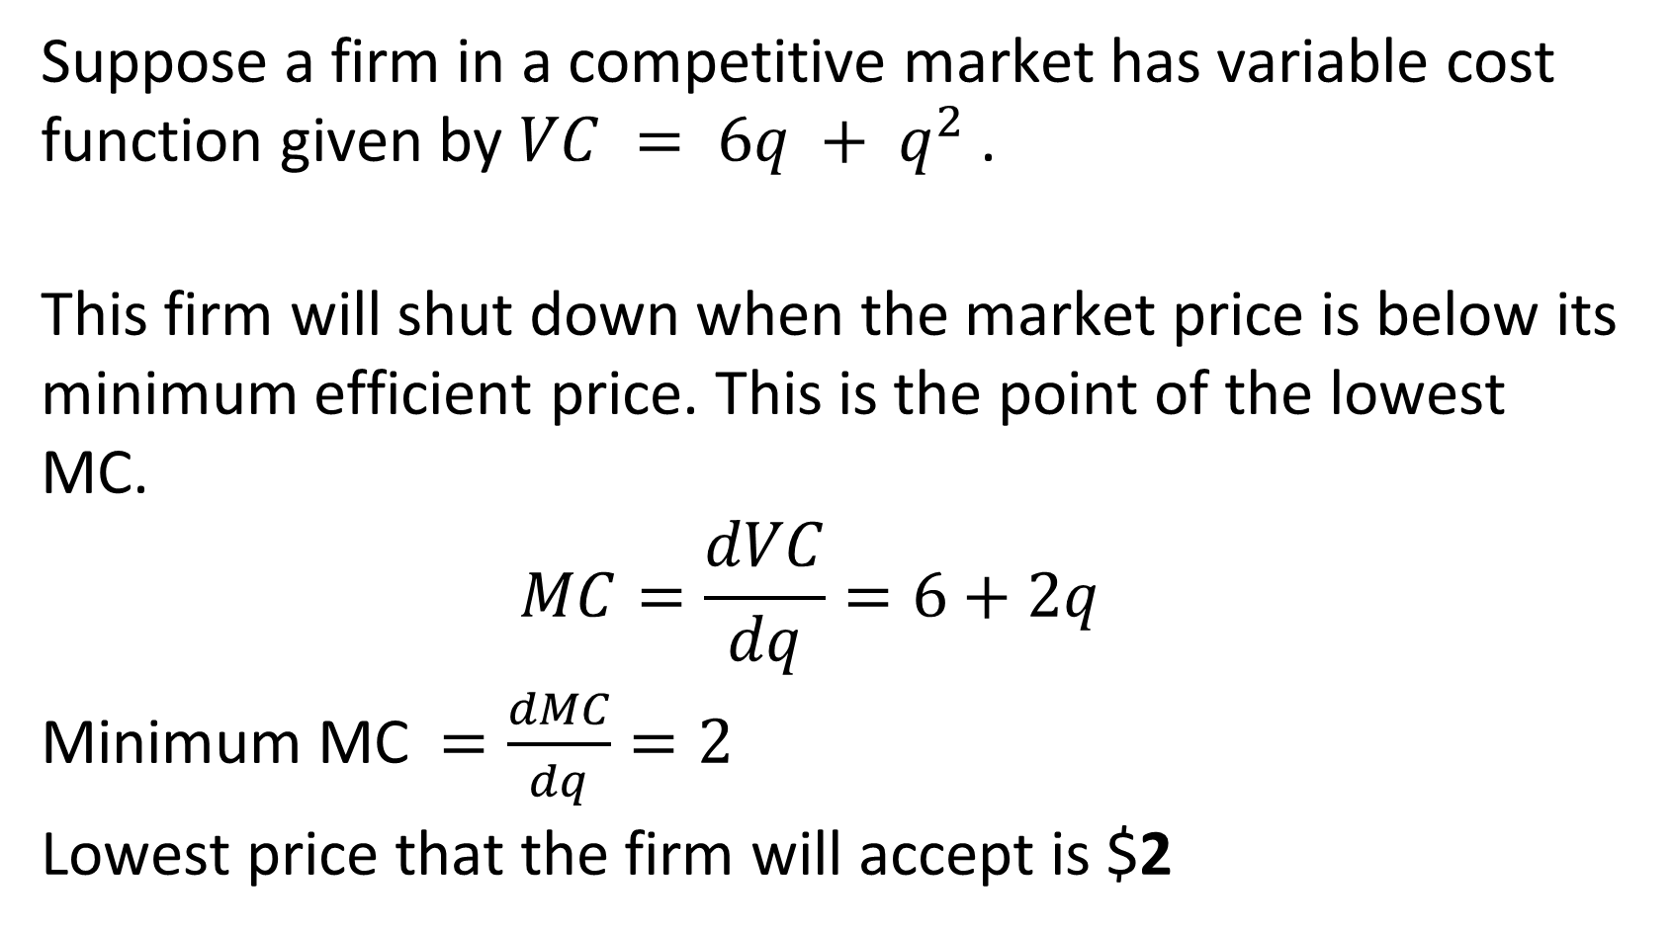
Question 13
Suppose a firm in a competitive market has variable cost function given by $VC = 6q + q^{2}$.
This firm will shut down when the market price is below its minimum efficient price. This is the point of the lowest MC.
$$MC=\frac{dVC}{dq}=6+2q$$
Minimum MC $=\frac{dMC}{dq}=2$
Lowest price that the firm will accept is $2

Slide 56
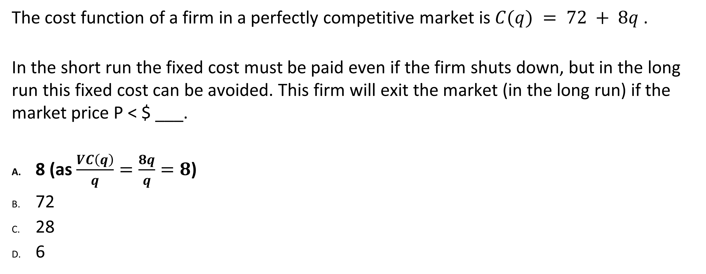
Question 14
The cost function of a firm in a perfectly competitive market is $C(q) = 72 + 8q$.
In the short run the fixed cost must be paid even if the firm shuts down, but in the long run this fixed cost can be avoided. This firm will exit the market (in the long run) if the market price P < $ ___.
8 (as $\frac{VC\left(q\right)}{q}=\frac{8q}{q}=8$)
72
28
6

Slide 57
The Short Run Supply Curve
The short run supply curve is the MC above the minimum AVC
Firms won’t supply when MC < AVC for the same reason why firms shutdown when P < AVC
producing below the minimum of AVC increases firm’s losses.

Slide 58
Short Run Market Supply Curve
Horizontal sum of the supply curves of all individual firms
The maximum number of firms in a market is fixed in the SR
Market supply curve at any price is n times the supply of an individual firm
The larger the n, the flatter (more elastic) the SR market supply curve is at each price
More firms → more responsive to changes in price → more elastic

Slide 59
Question 15
PC Enterprises is a perfectly competitive ﬁrm with costs which are identical to the costs of the other ﬁrms in PC’s market. Identify the correct statement
If ﬁxed costs must be paid in the short run and PC is operating with proﬁts equal to - $200,000 then we know that PC’s ﬁxed costs are less than $200,000.
Marginal revenue for PC does not have an inelastic region.
Barriers to entry allow PC to earn positive proﬁts in the long run.
In the long run equilibrium, PC operates where the slope of its average variable cost schedule is equal to zero

Slide 60
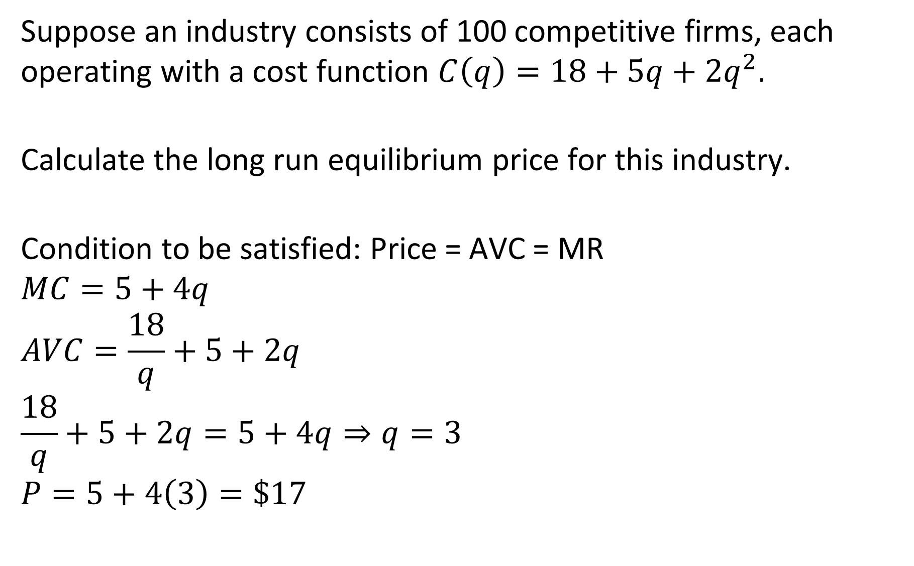
Question 16
Suppose an industry consists of 100 competitive firms, each operating with a cost function $C\left(q\right)=18+5q+2q^{2}$.
Calculate the long run equilibrium price for this industry.
Condition to be satisfied: Price = AVC = MR
$$MC=5+4q$$
$$AVC=\frac{18}{q}+5+2q$$
$$\frac{18}{q}+5+2q=5+4q⇒q=3$$
$$P=5+4\left(3\right)=\$17$$

Slide 61
MONOPOLY

Slide 62
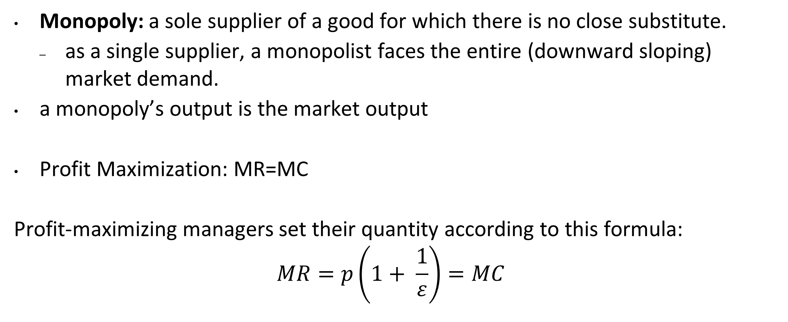
Monopoly
Monopoly: a sole supplier of a good for which there is no close substitute.
as a single supplier, a monopolist faces the entire (downward sloping) market demand.
a monopoly’s output is the market output
Profit Maximization: MR=MC
Profit-maximizing managers set their quantity according to this formula:
$$MR=p\left(1+ \frac{1}{ε}\right)=MC$$

Slide 63
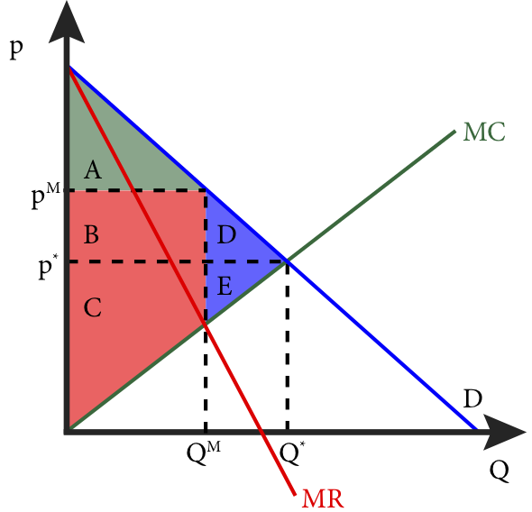
Comparison of Consumer and Producer Surplus
 | Perfectly Competitive | Monopoly | Change
Consumer Surplus, CS | A + B + D | A | - B - D
Producer Surplus, PS | C + E | C + B | B - E
Total Surplus | A + B + C + D + E | A + B + C | - D - E = DWL

Slide 64
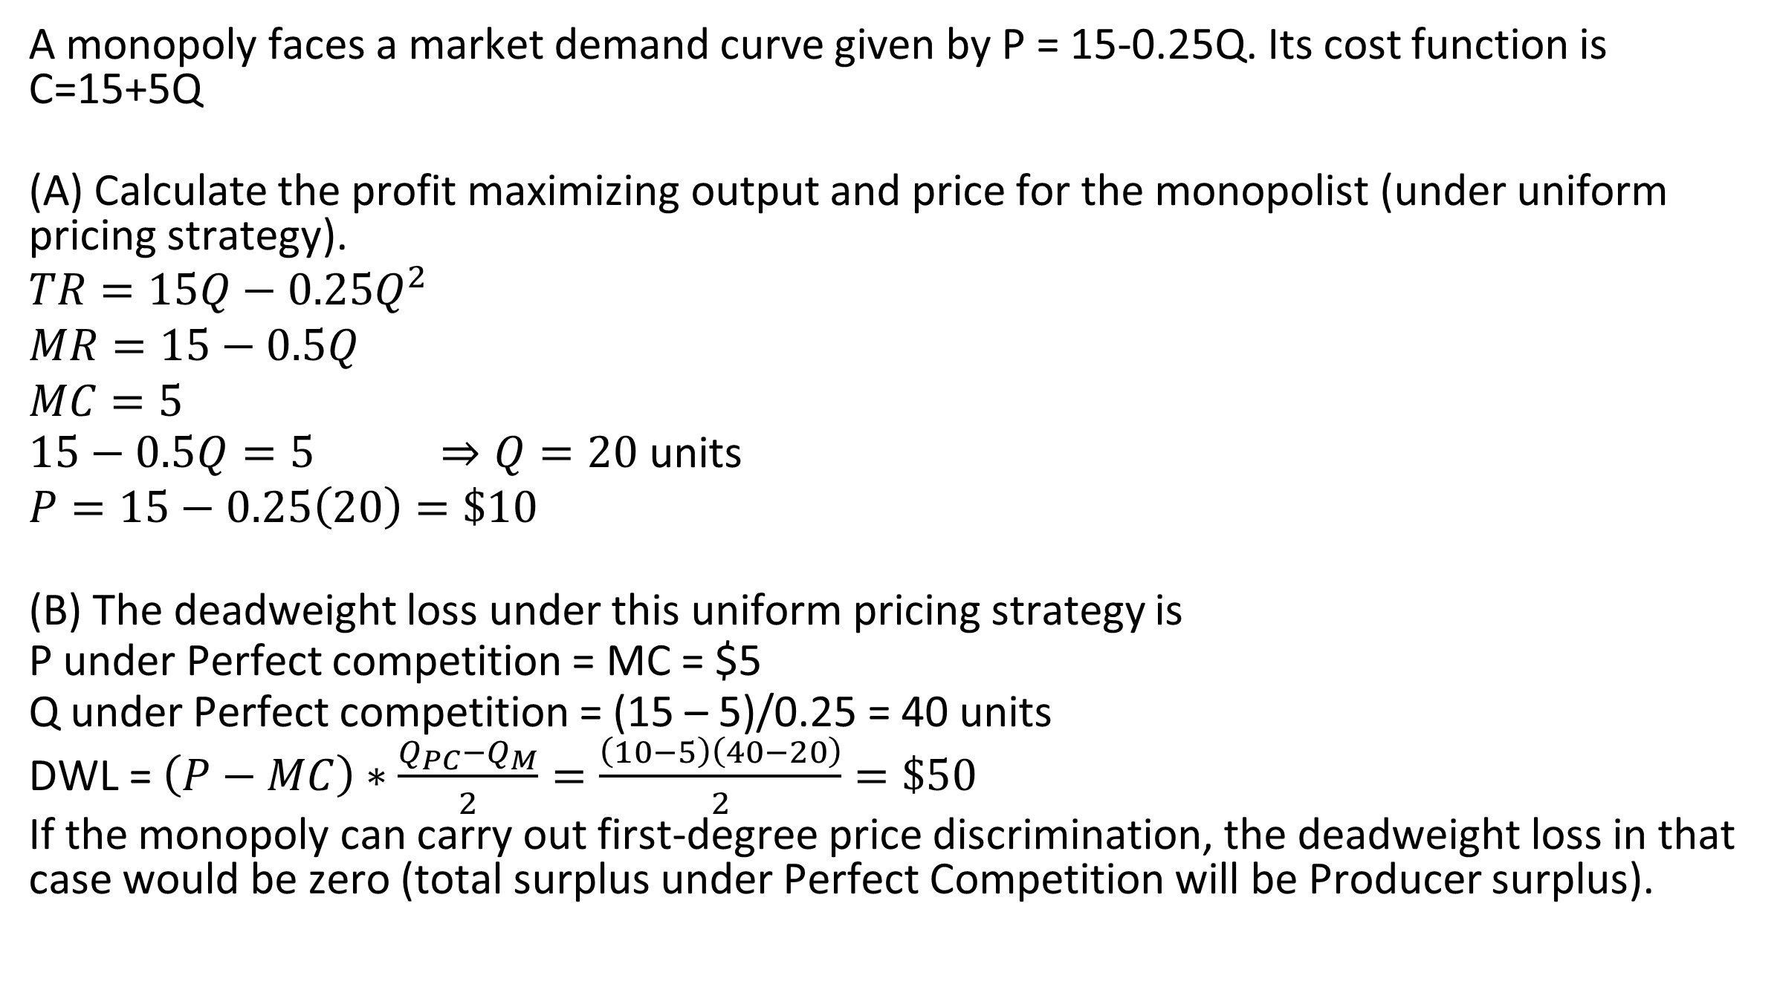
Question 17
A monopoly faces a market demand curve given by P = 15-0.25Q. Its cost function is C=15+5Q
(A) Calculate the profit maximizing output and price for the monopolist (under uniform pricing strategy).
$$TR=15Q−0.25Q^{2}$$
$$MR=15−0.5Q$$
$$MC=5$$
$15−0.5Q=5 ⇒Q=20$ units
$$P=15−0.25\left(20\right)=\$10$$
(B) The deadweight loss under this uniform pricing strategy is
P under Perfect competition = MC = $5
Q under Perfect competition = (15 – 5)/0.25 = 40 units
DWL = $\left(P−MC\right)∗\frac{Q_{PC}−Q_{M}}{2}=\frac{\left(10−5\right)\left(40−20\right)}{2}=\$50$
If the monopoly can carry out first-degree price discrimination, the deadweight loss in that case would be zero (total surplus under Perfect Competition will be Producer surplus).

Slide 65
PRICING WITH MARKET POWER

Slide 66
Pricing with Market Power
Perfect price discrimination: Monopolist charges the maximum price that each
consumer is willing to pay.
Multi-group price discrimination: Splitting consumers into two or more groups based on their demand curve and charging different prices to each group.
Non-linear Price Discrimination: Charging different prices based on the quantity
Two-Part Pricing: Charging an entry fee and a usage fee

Slide 67
Pricing with Market Power
Bundling: selling products together in sets
Pure Bundling: works when there is a negative correlation between the demands of consumers
Changes lower price but increases the number of consumers.
Mixed Bundling: allow the customer to buy the pure bundle or any of the bundle’s components separately
Peak Load Pricing: charging higher prices during periods of peak demand in other periods
used when there is a capacity constraint
increases profits and spreads demand during off-peak time

Slide 68
Question 18
The following table provides willingness to pay information (i.e. reservation prices) of 3 consumers for a wine tour and hotel. The marginal cost is zero for both the products.
Calculate the profit-maximizing mixed bundling prices (provide only the final answers; you don't need to show any work) (3 pts)
P(bundle) = 325
P(wine) = 175
P(Hotel) = 225
Total profit = $735
Consumer | Wine Tour | Hotel | Bundle
Jerry | 175 | 100 | 175+100 =275
Smita | 125 | 200 | 125+200 =325
Juhi | 100 | 225 | 100+225 =375

Slide 69
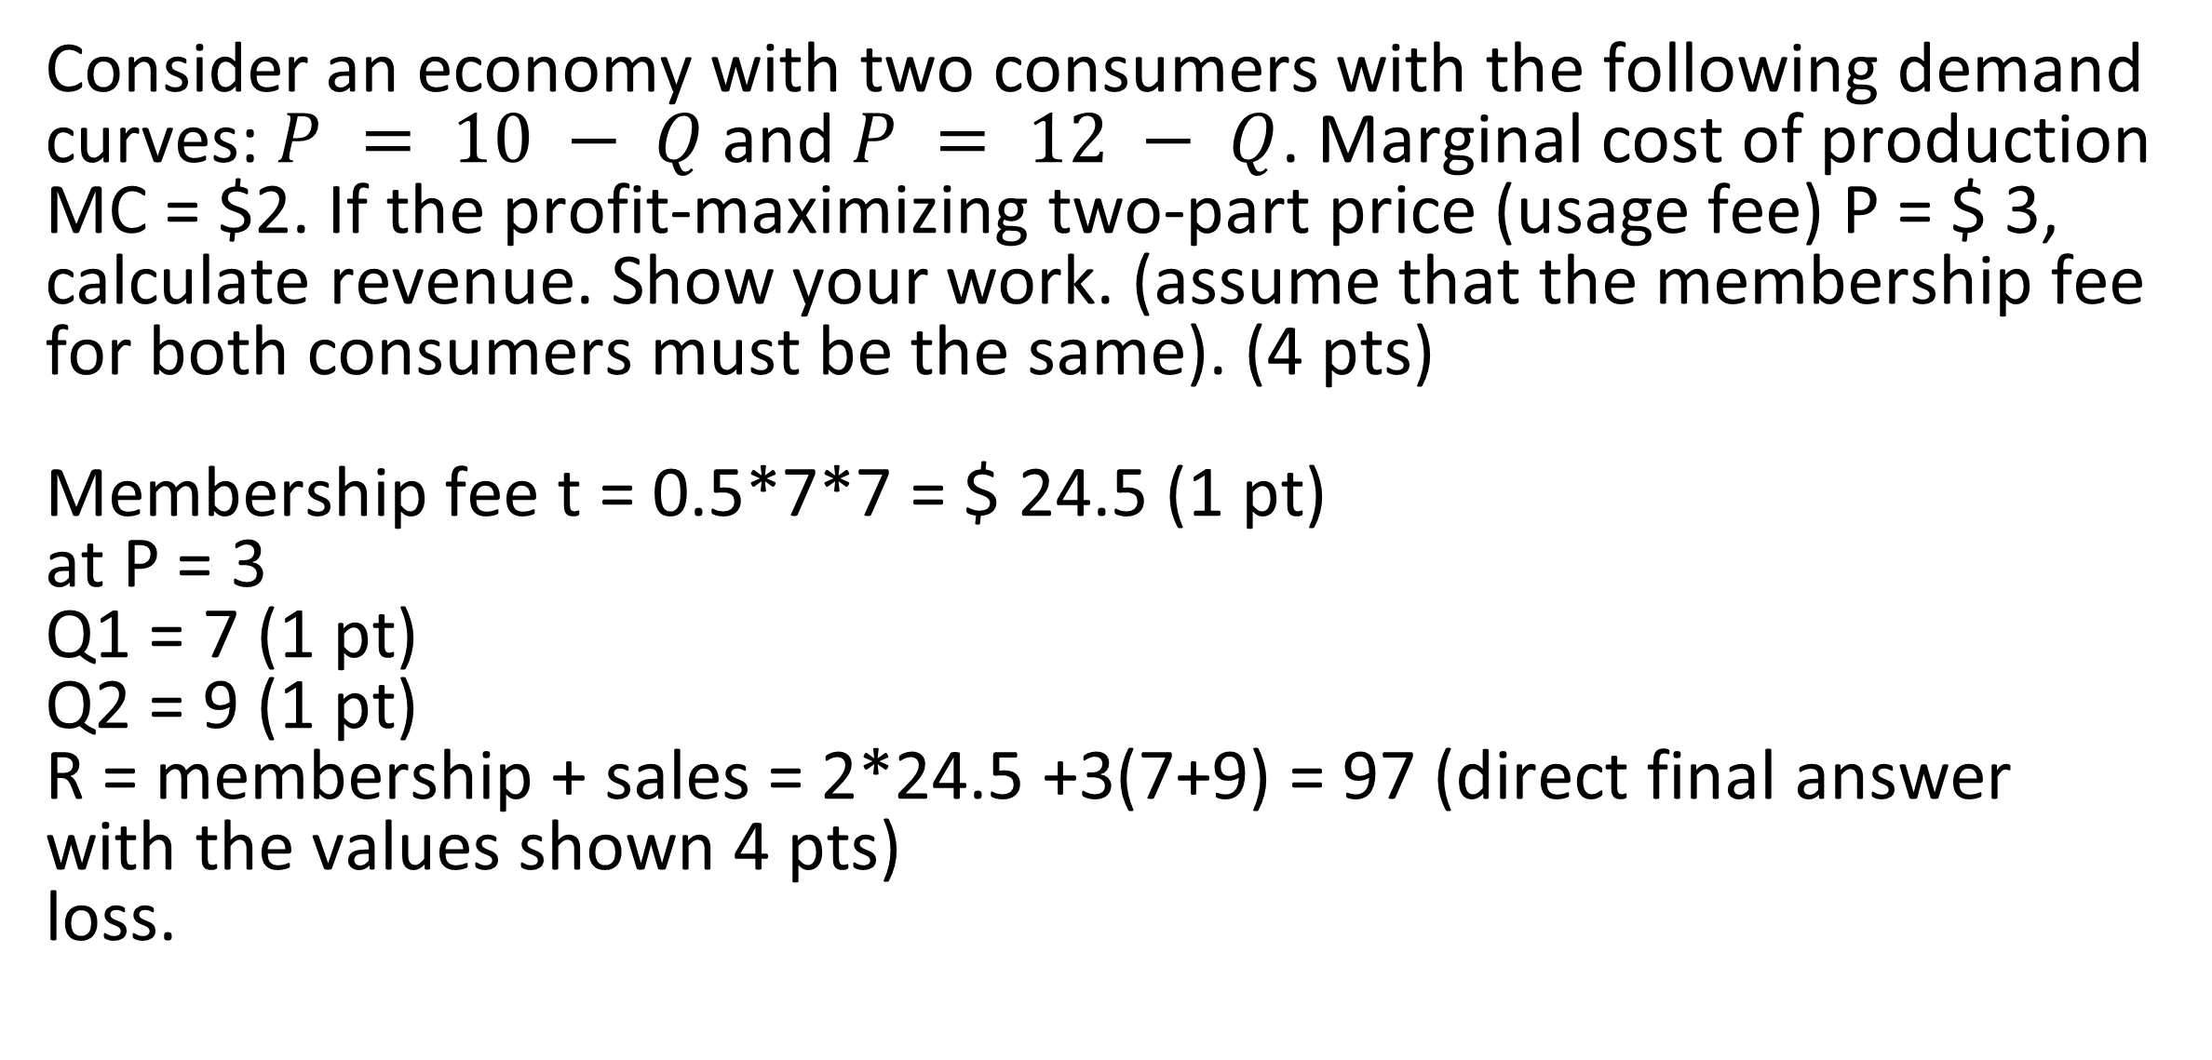
Question 19
Consider an economy with two consumers with the following demand curves: $P = 10 − Q$and $P = 12 − Q$. Marginal cost of production MC = $2. If the profit-maximizing two-part price (usage fee) P = $ 3, calculate revenue. Show your work. (assume that the membership fee for both consumers must be the same). (4 pts)
Membership fee t = 0.5*7*7 = $ 24.5 (1 pt)
at P = 3
Q1 = 7 (1 pt)
Q2 = 9 (1 pt)
R = membership + sales = 2*24.5 +3(7+9) = 97 (direct final answer with the values shown 4 pts)
loss.

Slide 70
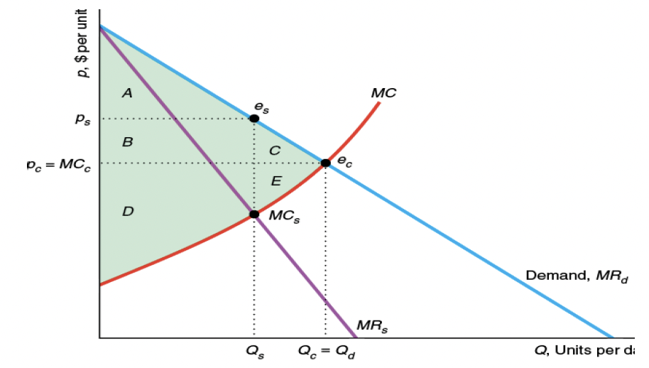
Question 20
This diagram compares perfect competition, perfect price discrimination, and uniform
monopoly pricing. Which statement is correct?
Under uniform monopoly pricing, consumer surplus is A.
Under perfect price discrimination, consumer surplus is A.
Under perfect competition, producer surplus is D.
Only perfect competition avoids deadweight loss.

Slide 71
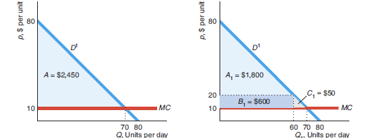
Question 21
The following diagram is related to two-part pricing. Assume that consumers are identical and that each consumer has the demand curve shown in each panel above. Which of the following statements is true?
A. Under profit-maximizing two-part pricing, the per-unit price of $20.
B. Under profit-maximizing two-part pricing, the access fee is $2,400.
C. Under profit-maximizing two-part pricing, consumer surplus is $2,450 per
person.
D. None of the above.

Slide 72
Question 22
The table provides the reservation prices for three students who are deciding what to do during in the summer. The students could travel to San Diego or New York. For this question, we will assume that these are the only students, and the marginal cost is 0 for both choices. A travel agency is considering whether to use stand-alone pricing or pure bundling pricing strategy.
 | New York | San Diego | Bundle
Steven | 110 | 100 | ?
Brian | 105 | 125 | ?
Carl | 100 | 150 | ?
A. Fill in the willingness to pay for the bundles in the above table
B. With stand-alone pricing, France should be priced at ________ and Germany should be priced at ________. The profit from both products is ________.
C. With pure bundling, the profit-maximizing price for the bundle is ________, and the profit is ________.

Slide 73
Question 22
 | New York | San Diego | Bundle
Steven | 110 | 100 | 210
Brian | 105 | 125 | 230
Carl | 100 | 150 | 250
Fill in the willingness to pay for the bundles in the above table:
Bundle value = New York value + San Diego value
B. New York – profit maximizing price:
at $110 – profit = 110*1= 110; at $105 – profit = 105*2 = 210; at $100 – profit = 100 * 3 = 300
Choose price with highest profit = $100
San Diego profit maximizing price:
at $100– profit = 100*3= 300; at $125 – profit = 125*2 = 250; at $150 – profit = 150 *1 = 150
Choose price with highest profit = $100
Total profit = 300 + 300 = $600 C. With pure bundling – profit maximizing price:
at $210 – profit = 210*3= 630; at $230 – profit = 230*2 = 460; at $250 – profit = 250*1 = 250
Choose price with highest profit = $210
Profit = $630

Slide 74
OLIGOPOLY

Slide 75
Oligopoly
Oligopolies are characterized by few sellers, limited entry, homogeneous or differentiated products, and firm’s awareness of strategic interdependence between each other.
Cartels: formed when oligopolistic firms collude in setting prices or quantities to raise their profits
Each member agrees to reduce its output from the level of output if it acted independently → market price rises and firms earn higher profits
Cartels tend to produce the output analogous to monopolies → helps achieve the highest possible collective profit

Slide 76
Oligopoly
Cournot Duopoly: two firms compete in choosing quantities
Bertrand Duopoly: two firms compete in choosing prices
Best Response Functions: shows the firm’s best output as a function of the other firm’s output and depends on the firm’s marginal cost.
Nash-Cournot Equilibrium: the set of quantities chosen by firms where no firm can obtain higher profits by choosing a different quantity (holding the quantities of all other firms constant) → intersection of best-response curves

Slide 77
Solving Cournot Model and Deriving Best Response Functions
Step 1: Find the residual demand function
Step 2: Use the residual demand function to find the MR equation of each firm
Step 3: Set MR = MC for both firms
Step 4: Solve for QA and QB
Step 5: Use Q to find the price

Slide 78
Solving Cournot Model and Deriving Best Response Functions
Explanations of Steps
Step 1: For Cournot oligopolies, where there are only two firms that are identical in marginal cost and their demand curves (this is also called a duopoly), we look for their residual demand curves so we can solve for the best-response functions.
Because the two firms compete with one another, they consider each other’s behavior when choosing profit-maximizing output
The firms are concerned with the residual demand curve, which shows the market demand that is not met by other sellers at any given price

Slide 79
Solving Cournot Model and Deriving Best Response Functions
Explanations of Steps
Step 2: Once we know the residual demand function, we want to find the MR equation so we can set the profit maximizing condition that a firm should follow to maximize its profit given the behavior of the other firm
The firm’s best response - its profit maximizing output given the output of the other firm - is the output that equates its marginal revenue and its marginal cost
Because the two firms have the same marginal cost and demand curves, their best-response functions will be identical

Slide 80
Solving Cournot Model and Deriving Best Response Functions
Explanations of Steps
Step 4: To solve for QA and QB, we take the best response functions of one firm and plug it into another. This will give us the quantity a firm should produce in response of another.

Slide 81
Question 23
There are two firms in a Cournot duopoly. The market demand function is Q = 339 – P and the cost function is C = 147Q. Find the equilibrium price, the quantity produced by each firm, and the profit of each firm.

Slide 82
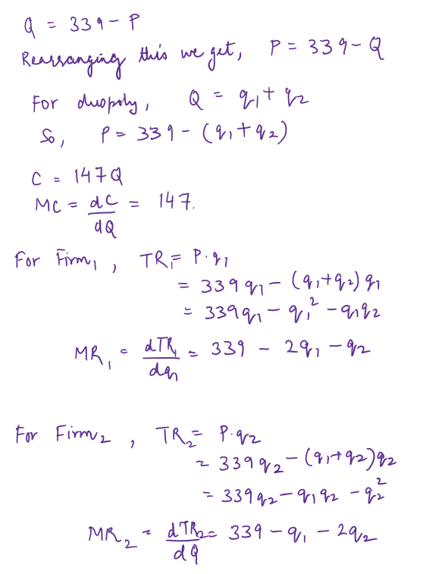
Question 23

Slide 83
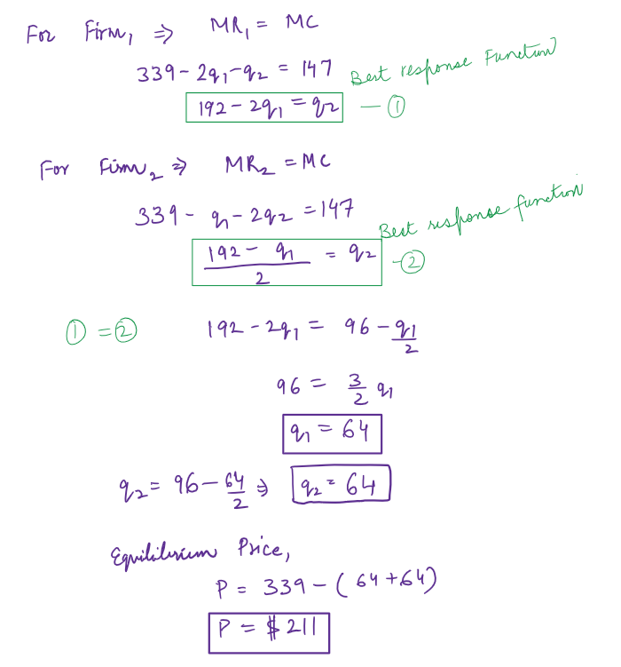

Question 23

Slide 84
Question 24
Two firms compete in the Canadian market for supplying raw canola oil which is perceived as a homogeneous product. The demand curve faced by these two firms is P = 24 - Q where P is the price of canola oil and Q is the total quantity offered for sale by the two firms. Marginal cost for Firm 1 is $4 and marginal cost for Firm 2 is $8. Neither firm has any fixed costs.
(a) Assume the two firms compete according to the Cournot-Nash equilibrium concept, i.e. they compete in quantities and make their production decisions simultaneously.
Calculate the equilibrium quantity and the equilibrium profits for each firm.

Slide 85


Question 24

Slide 86

Question 25
Refer to Q-24 To eliminate competition, Firm 1 is contemplating the purchase of firm 2. After the buyout, firm 1 would supply the entire market from its original plant and its profits will equal 100. What is the maximum amount that firm 1 would pay for firm 2? What is the minimum amount that firm 2 would accept from firm 1?
By buying firm 2, firm 1 becomes a monopoly. Profit maximization for a monopoly: $MR=MC$
$$MR=24−2q_{1}$$
$$24−2q_{1}=4⇒q_{1}=10 units$$
Profit $π=Pq_{1}−cq_{1}=10\left(24−10\right)−10\left(4\right)=\$100$
With buying firm 2, firm 1 makes 100 – 64 = 36 more than by playing Nash-Cournot game. So Firm 1 is willing to pay up to $36 to buy out firm 2 and monopolize the market. (1 pt)
Firm 2 makes $16 by playing Nash-Cournot game and so needs minimum $16 compensation to be bought out

